Slide 1

EddySonix ARS Technology: Redefining Precision in Aerospace Testing
Advanced NDT Solutions for High-Precision Aerospace Components
Notes:
Welcome to the EddySonix ARS technology presentation. Our Acoustic Resonance Sweep, or ARS, is a cutting-edge solution specifically designed for the precision demands of aerospace non-destructive testing applications. The ARS system brings advanced capabilities tailored to detect even the smallest defects, crucial in high-stakes industries where component integrity is essential. This technology truly represents EddySonix's commitment to innovation and reliability in ensuring safety and performance in critical component testing.

Slide 2
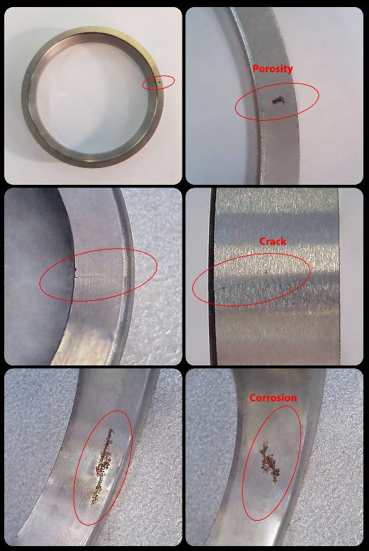
Overview of the ARS System: Precision Testing for Critical Defects
Purpose:
  Designed for precision testing in aerospace, ARS detects even the smallest defects in critical components.
Key Approach Highlights:
  High-frequency excitation for detecting fine details
  Multi-channel analysis captures comprehensive mode data
  Advanced signal processing ensures high-resolution results
Detectable defects with ARS include porosity and cracks, identifying voids as small as 0.2mm.
Notes:
The ARS system excels with complex materials often found in aerospace manufacturing, like Titanium alloys and parts created through Additive Manufacturing or Metal Injection Molding. These materials require a high degree of precision because even micro-defects like porosities or small cracks can significantly impact structural integrity. Our system has been extensively validated through R&D projects with aerospace partners, where results are cross-verified using industry standards like CT-scans. This makes the ARS a trusted and reliable solution in critical material testing.

Slide 3
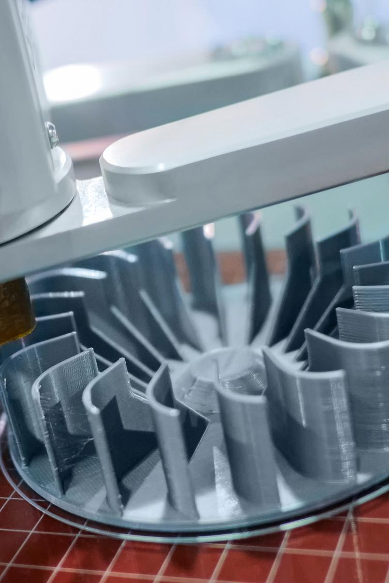
Precision Testing for Complex Aerospace Materials
Specialized for Advanced Materials:
  Tailored for Titanium alloys, Additive Manufacturing (AM), and Metal Injection Molding (MIM) processes.
Ensuring Safety in Aerospace Components:
  Detects micro-defects such as porosities and cracks that impact structural integrity.
Validated Through R&D:
  Proven effectiveness in aerospace R&D with cross-validation against CT-scan standards.
Notes:
The ARS system excels with complex materials often found in aerospace manufacturing, like Titanium alloys and parts created through Additive Manufacturing or Metal Injection Molding. These materials require a high degree of precision because even micro-defects like porosities or small cracks can significantly impact structural integrity. Our system has been extensively validated through R&D projects with aerospace partners, where results are cross-verified using industry standards like CT-scans. This makes the ARS a trusted and reliable solution in critical material testing.

Slide 4

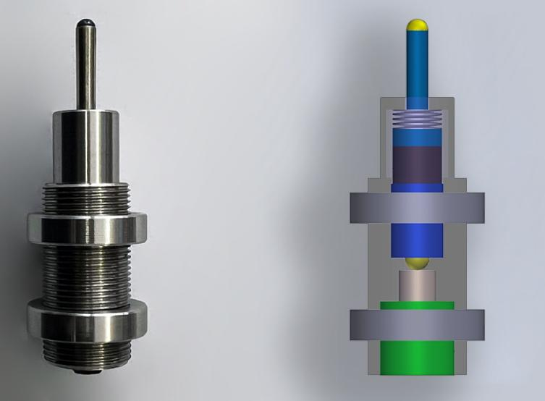
High-Frequency Excitation: Detecting Fine Defects
Wide Bandwidth:
  Covers up to 1 MHz frequency range, essential for detecting minute structural flaws.
Precision Mode Capture:
  Ensures all relevant vibrational modes are accurately captured for effective defect identification.
Importance of High Frequency:
  Higher frequencies enhance sensitivity to subtle structural issues, in line with ASTM E2001-13 standards.
Notes:
High-frequency excitation is a crucial component of the ARS system, as it allows us to detect very fine structural irregularities. Our system operates within a broad frequency range up to 1 MHz, capturing all the essential vibrational modes needed to identify defects accurately. According to ASTM standards, higher frequencies are necessary because they align the wavelength with the size of tiny defects, like micro-cracks or porosities, making them detectable. This sensitivity ensures that even the smallest defects, which could impact the overall integrity, are not missed in quality assessments.

Slide 5
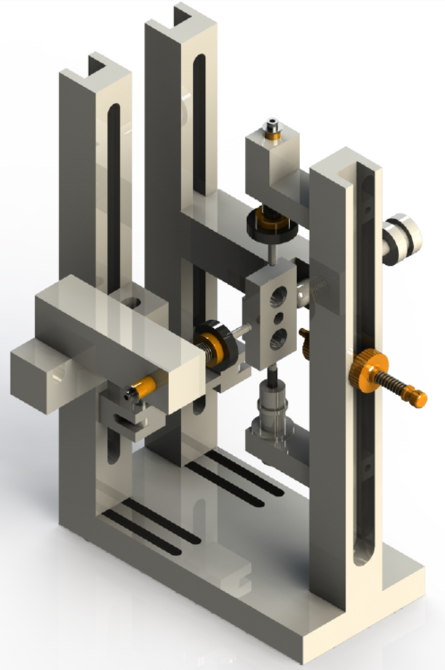
Multi-Channel Pickup: Comprehensive 3D Mode Capture
Strategic Pickup Placement:
  Multiple pickups are strategically placed to capture modes from various angles, enhancing test accuracy.
Enhanced Mode Analysis:
  The multi-channel setup improves detection and labeling accuracy by capturing more mode details than single-pickup systems.
Full Vibrational Profile:
  Ensures detailed and complete mode detection, critical for high-precision analysis.
Notes:
The ARS system’s multi-channel pickup feature is a significant advancement in capturing comprehensive mode data. By strategically placing multiple pickups around the component, we capture vibrational modes from multiple angles, which is essential for accurate defect detection. Unlike single-pickup systems, which may miss certain modes due to nodal positioning, our multi-channel setup enhances mode detection and labeling accuracy. This approach enables us to analyze a full vibrational profile, ensuring no critical modes are overlooked, and supports our commitment to thorough, high-precision testing.

Slide 6
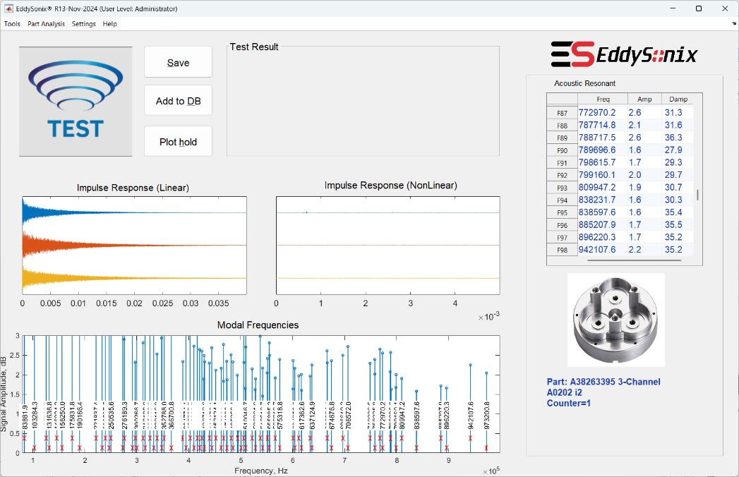
Comprehensive Mode Analysis for Precise Defect Detection
Extended Mode Tracking:
  Tracks hundreds of modes with flexible capacity, enabling detailed analysis of intricate components without limitations.
High-Volume Mode Coverage:
  High volume of mode analysis detects small, random defects across the component’s entire structure.
Thorough Defect Detection:
  No critical anomalies are overlooked, providing confidence in testing high-precision components.
Notes:
Our ARS system performs comprehensive mode analysis, routinely examining between 200 and 300 modes—far beyond the 10-20 modes typically checked in traditional applications. This extensive mode coverage allows us to detect small, randomly located defects throughout the component’s volume, ensuring no critical anomalies are missed. By leveraging high-volume mode tracking, our system provides robust and reliable defect detection, ideal for high-precision parts and advanced quality control requirements.

Slide 7
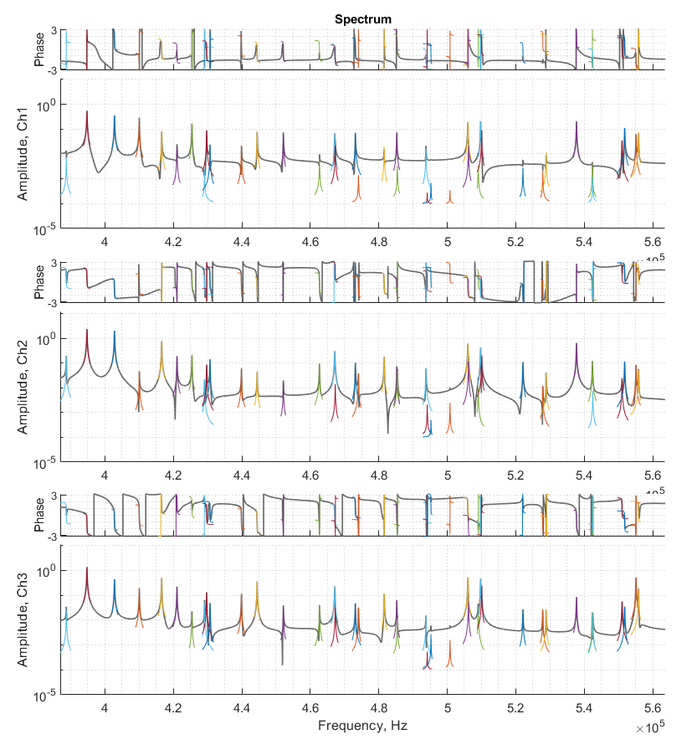
High-Resolution, Low-Noise Spectrum for Detailed Analysis
Advanced Sweep Excitation:
  Customizable sweep synthesis in the frequency domain with adjustable magnitude, group delay, and amplitude modulation, ensuring a clean, high-resolution spectrum, ultra-fast sweep, and optimized frequency coverage.
Low-Noise Impulse Response:
  Delivers a clean, low-noise spectrum with detailed amplitude and phase data for precise defect identification.
Enhanced Data Quality:
  Enables high-resolution analysis essential for identifying minute defects in complex structures.
Notes:
This slide highlights ARS’s ability to produce a high-resolution, low-noise spectrum, which is crucial for detailed defect analysis. Through advanced sweep excitation, we can customize parameters to optimize the frequency range. The result is a clean impulse response, capturing both amplitude and phase with exceptional clarity. This low-noise spectrum enables ARS to identify even the smallest flaws within complex structures, ensuring thorough and precise defect detection.

Slide 8
Accurate Mode Fitting for Precise Defect Detection
Advanced Fitting Algorithm:
  Beyond peak detection, ARS employs a fitting algorithm that precisely decomposes complex mode patterns.
Comprehensive Mode Data:
  Captures frequency, damping, and amplitude across channels for each mode.
Enhanced Defect Sensitivity:
  Identifies closely spaced, weak, or hidden modes to ensure no critical defects are missed.
Notes:
The ARS system goes beyond traditional peak detection by using an advanced fitting algorithm for precise mode decomposition. This process provides comprehensive mode data, capturing each mode’s frequency, damping, and amplitude across multiple channels. With this enhanced sensitivity, ARS is able to detect even closely spaced or hidden modes, ensuring that no critical defects are overlooked. This capability is especially important in high-precision applications, where undetected flaws can have serious consequences.

Slide 9
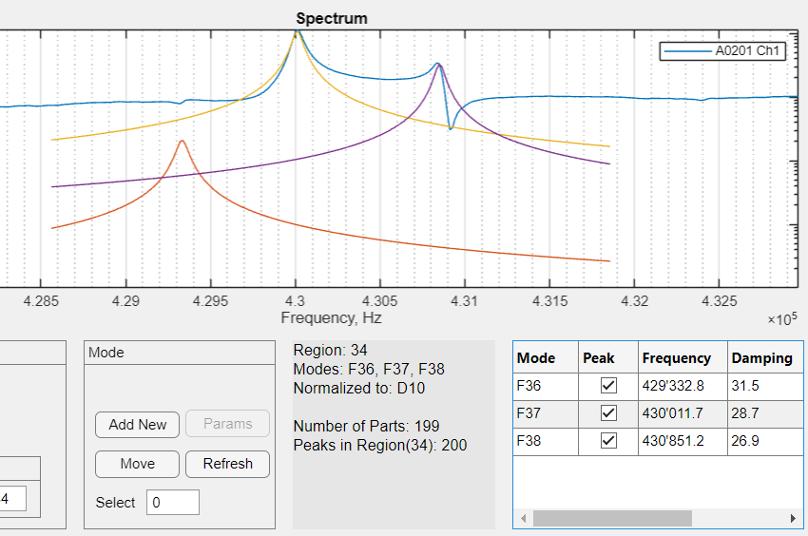
Precise Mode Labeling for Reliable Tracking
Consistent Mode Tagging:
  Sequentially labels each mode (F1, F2…) for precise and reliable tracking throughout analysis.
Advanced Pattern Recognition:
  Utilizes pattern recognition to differentiate closely spaced modes, minimizing the risk of mislabeling.
Multi-Channel Verification:
  Cross-validates modes across multiple channels to ensure accurate labeling even in dense mode regions.
Notes:
Accurate mode labeling is crucial in ensuring reliable defect detection, especially in complex components with closely spaced modes. ARS achieves this through consistent sequential tagging, assigning each mode a unique label like F1, F2, and so on, which helps with precise tracking. In dense mode regions, ARS uses advanced pattern recognition to distinguish modes effectively, reducing the chance of mislabeling. Additionally, multi-channel validation cross-references data from multiple pickups, further enhancing accuracy and reliability in complex testing scenarios.

Slide 10
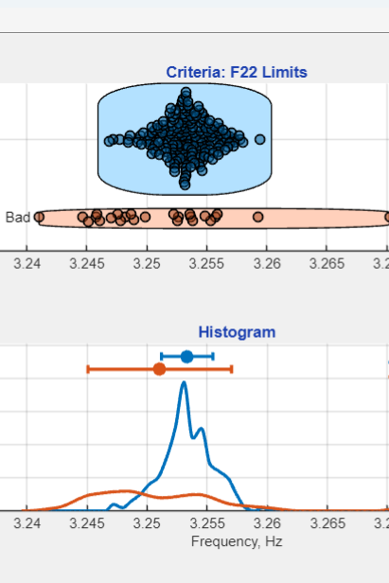
Structured Criteria and Multi-Level Analysis for Defect Detection
Database Options:
  Unknown Samples: Creates a database with 200+ unknown samples for multi-level anomaly detection.
  Known Samples: Uses classified good and defective parts to refine criteria for targeted analysis.
Single- and Multi-Variable Analysis:
  Single-Variable Analysis: Analyzes frequency and damping range for each mode based on statistical limits.
  Multi-Variable Analysis: Employs machine learning and statistical models to detect subtle patterns across multiple variables.
Notes:
The ARS system utilizes a structured approach to defect detection through criteria definition and multi-level analysis. It begins with building a database. For unknown samples, we gather over 200 parts, running them through multi-level anomaly detection to identify defects. For known samples, the database includes pre-classified good and defective parts, allowing us to refine our criteria for specific defect types. At the analysis level, we perform single-variable analysis to check each frequency’s range and damping against statistical limits, excluding outliers. For a more comprehensive assessment, multi-variable analysis leverages advanced models, using machine learning and statistical methods to detect subtle patterns across variables, enhancing our defect detection accuracy.

Slide 11
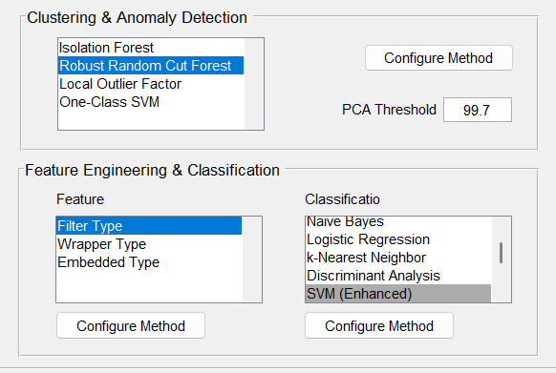
Adaptive, Learning-Based Detection for Enhanced Accuracy
Intelligent Decision-Making:
  Analyzes a wide database of samples, refining detection models to improve accuracy, even with limited defect-free samples.
Multi-Variable Frequency Assessment:
  Evaluates modal frequency harmony, distinguishing between defect-free and defective parts with high precision.
Defect Severity Evaluation:
  Identifies disruption levels in components, allowing graded assessment of defect severity for better decision-making.
Notes:
Our ARS system is designed to adapt and learn, making defect detection more accurate over time. Using an intelligent decision-making module, it refines its criteria by analyzing a diverse database of samples, even when there are limited confirmed defect-free parts. This adaptive capability is particularly valuable in high-stakes applications where data on new components may be limited. The system performs multi-variable assessments, examining modal frequency harmony to distinguish defect-free parts from those with potential flaws. Additionally, it goes beyond simple detection by evaluating the severity of defects, providing a graded understanding that helps in making informed decisions about the component’s suitability.

Slide 12
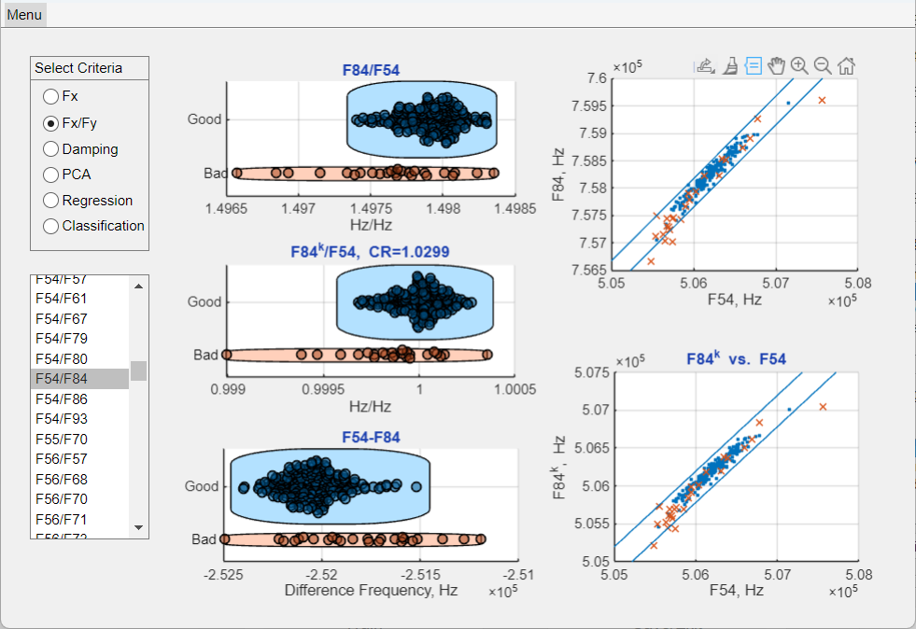
Bi-Variable Frequency Ratios for Stable, Sensitive Defect Detection
Stable Detection Through Frequency Ratios:
  Environmental factors, such as temperature shifts, affect all frequencies equally. Using frequency ratios (Fx/Fy) compensates for these changes, maintaining detection reliability.
Increased Defect Sensitivity:
  Localized defects cause unique frequency shifts. Ratios reveal these subtle differences, enhancing sensitivity to small anomalies.
Detecting Mode Relationships:
  Frequencies are interdependent. Analyzing ratios helps identify deviations from expected patterns, indicating potential structural issues.
Notes:
The ARS system uses bi-variable criteria, specifically frequency ratios, to achieve stable and sensitive defect detection. When environmental factors like temperature or mass variations shift all frequencies equally, frequency ratios help us maintain consistency by compensating for these uniform shifts. This makes ARS highly reliable under variable testing conditions. Additionally, frequency ratios increase defect sensitivity. Localized defects often cause specific frequency shifts, which can be hard to detect with single-frequency analysis. By analyzing ratios, we reveal these subtle differences, allowing us to detect structural anomalies that could otherwise be missed. The system also uses ratios to detect deviations from expected frequency patterns, further improving our ability to identify potential issues in component integrity.

Slide 13
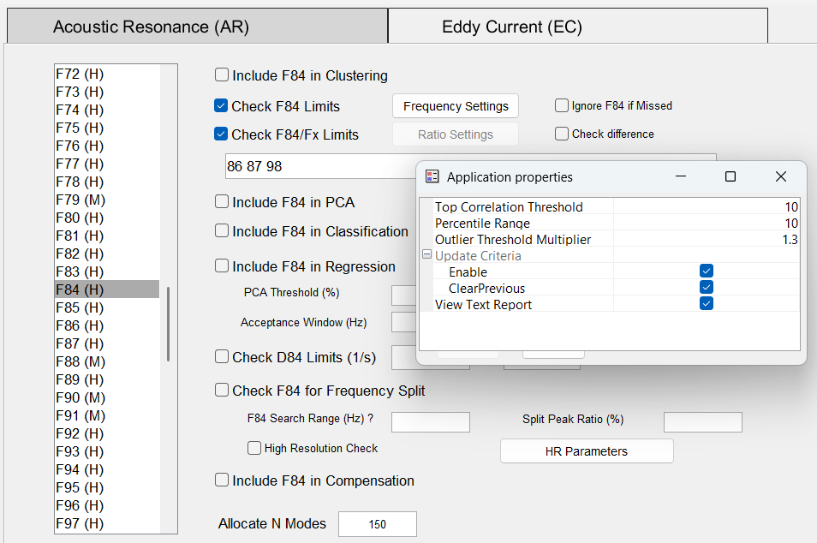
Automated Feature Selection for Efficient Defect Analysis
Handling High Volume Ratios:
  For example, with 100 modes, there are over 5,000 possible Fx/Fy ratios. ARS automates the selection process, simplifying analysis by eliminating manual review challenges.
Smart Selection Based on Key Criteria:
  Software identifies impactful ratios based on correlation, distribution, and defect relevance, filtering out non-informative data.
Adaptive Thresholds:
  Automatically adjusts thresholds in response to data characteristics, focusing only on the most sensitive and impactful ratios.
Notes:
Our ARS system is designed to handle the complexity of bi-variable analysis by automating feature selection. With over 5,000 possible frequency ratios across 100 modes, manually analyzing this data is impractical. Instead, our software intelligently identifies the most relevant ratios based on their correlation, distribution, and sensitivity to defects, which ensures that only the impactful ratios are selected. Additionally, ARS uses dynamic thresholds, meaning it adjusts its criteria in real-time as it processes data, ensuring it focuses only on the most sensitive and informative features. This automated feature selection not only streamlines the analysis process but also enhances defect detection accuracy.

Slide 14
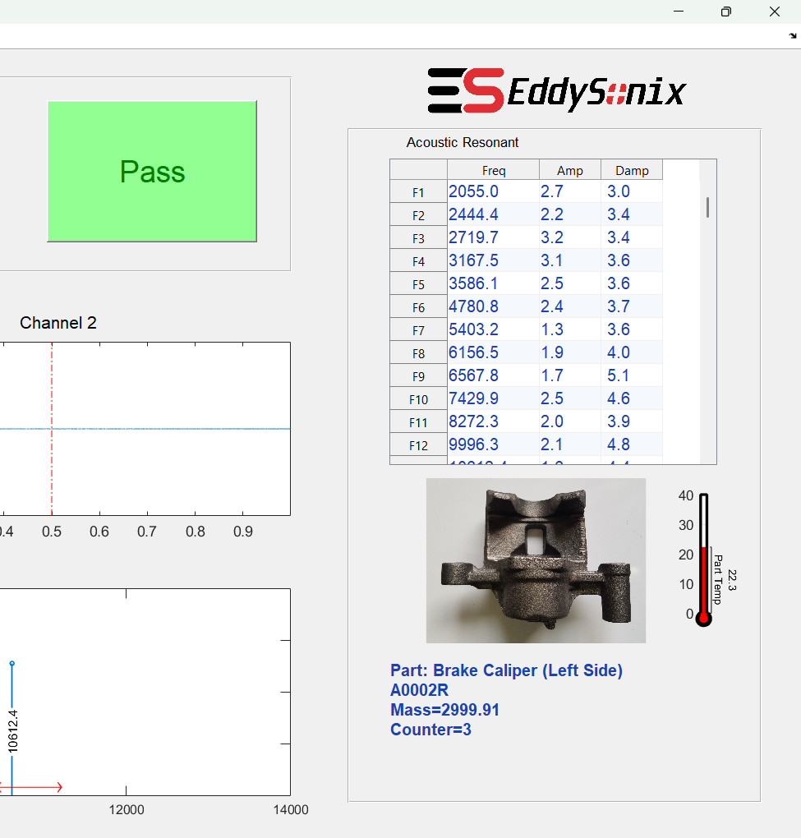
Temperature and Mass Compensation for Accurate Testing
Temperature Compensation:
  Temperature shifts all frequencies (ΔF / F = -k * Δ(T)). ARS compensates through:
  Direct Measurement: Adjusts frequencies based on the actual temperature of the part.
  Virtual Compensation: Uses stable reference frequencies to correct shifts, eliminating the need for direct measurement.
Mass Compensation:
  Direct Measurement: Weighs the part to apply precise mass-based frequency adjustments.
  Virtual Prediction: Uses stable frequencies to estimate mass effects, allowing automatic adjustment.
Notes:
Environmental factors such as temperature, along with mass variations, can significantly impact frequency readings, which in turn affects defect detection accuracy. Our ARS system includes built-in temperature compensation, using either direct measurements of the part’s temperature or virtual compensation through stable reference frequencies. This ensures that temperature-induced frequency shifts do not compromise the results. Similarly, for mass compensation, the system can either weigh the part directly or predict mass effects using stable frequencies, adjusting automatically. These compensations are essential to ensure ARS provides reliable and accurate testing results under varying environmental conditions.

Slide 15
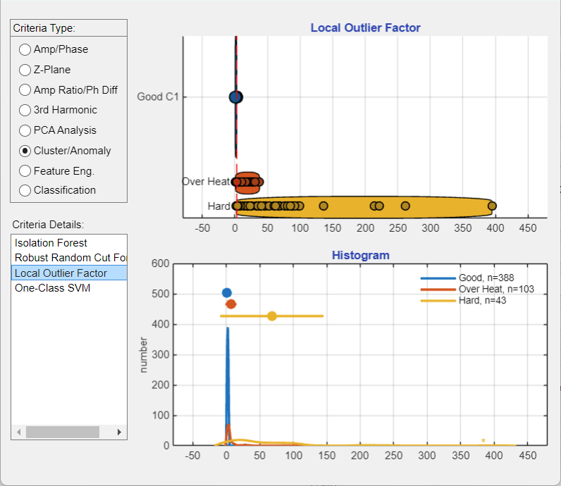
Advanced Multi-Variate Analysis for Enhanced Defect Detection
Principal Component Analysis (PCA):
  Reduces data complexity by transforming correlated features into fewer, uncorrelated components, enhancing focus on key defect indicators.
Mahalanobis Distance:
  Measures each sample's deviation from the multivariate mean, identifying outliers that could indicate defects.
Anomaly Detection Techniques:
  Local Outlier Factor: Flags samples that deviate significantly from neighboring data points.
  One-Class SVM: Models the normal data distribution, detecting anomalies that signal rare defects.
Notes:
The ARS system employs advanced multi-variate analysis techniques to improve defect detection accuracy. We use Principal Component Analysis, or PCA, to reduce data complexity, focusing only on the most informative components. This enables us to target key defect indicators more effectively. For outlier detection, the system calculates Mahalanobis Distance to measure each sample's distance from the multivariate mean, flagging potential defects. Additionally, we use anomaly detection methods like the Local Outlier Factor and One-Class SVM, which help detect rare or subtle defects by identifying patterns that deviate significantly from normal behavior. Together, these techniques ensure that ARS can reliably detect even the smallest irregularities.

Slide 16
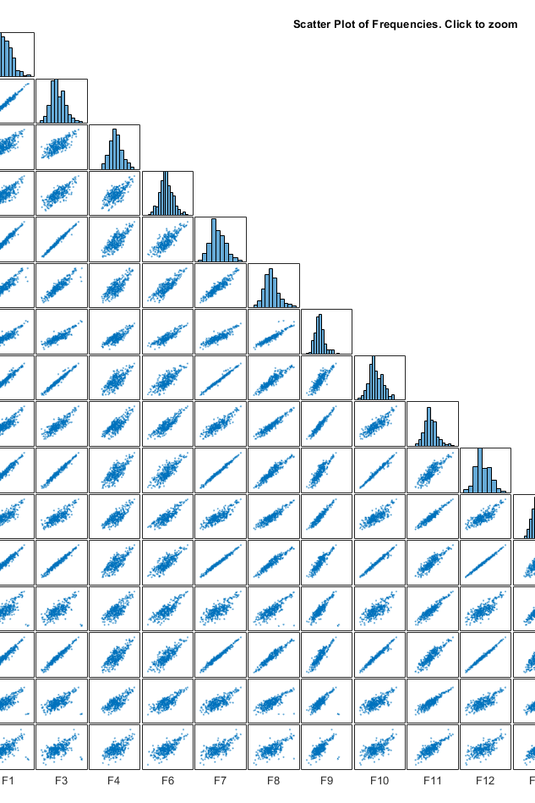
Comprehensive Statistical Analysis & Configuration Tools
Batch Testing:
  Automated offline testing for multiple parts, with detailed reports that include defect identification and failure analysis.
Comparison Tools:
  Enables offline comparison of spectra, modes, and results across parts to detect variances.
Advanced Visualization:
  Provides histograms, clustering, and classification for in-depth single- and multi-variable analysis, supporting model training and configuration.
Signal Analysis:
  Analyzes raw and processed signals to identify critical frequency and amplitude changes tied to defects.
Notes:
Our ARS system is equipped with a suite of statistical analysis and configuration tools that enhance defect detection and streamline the testing process. With batch testing, we can automatically process multiple files offline, generating comprehensive reports that detail any detected defects and their possible causes. The comparison tools allow for side-by-side analysis of different parts, helping identify variances in spectra, modes, and other key parameters. Additionally, we offer advanced visualization tools, including histograms, clustering, and classification, to support both single- and multi-variable analysis. These features are especially useful for model training and configuration, making it easier to adapt ARS for specific applications. Finally, signal analysis tools let us examine both raw and processed signals to detect critical frequency and amplitude changes that indicate defects, providing a thorough and reliable testing solution.

Slide 17
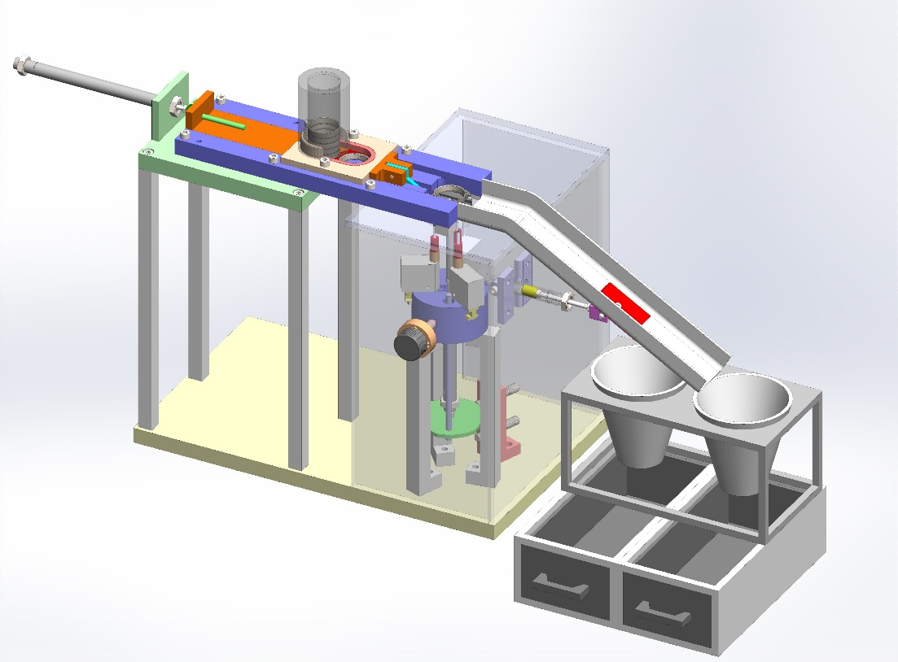
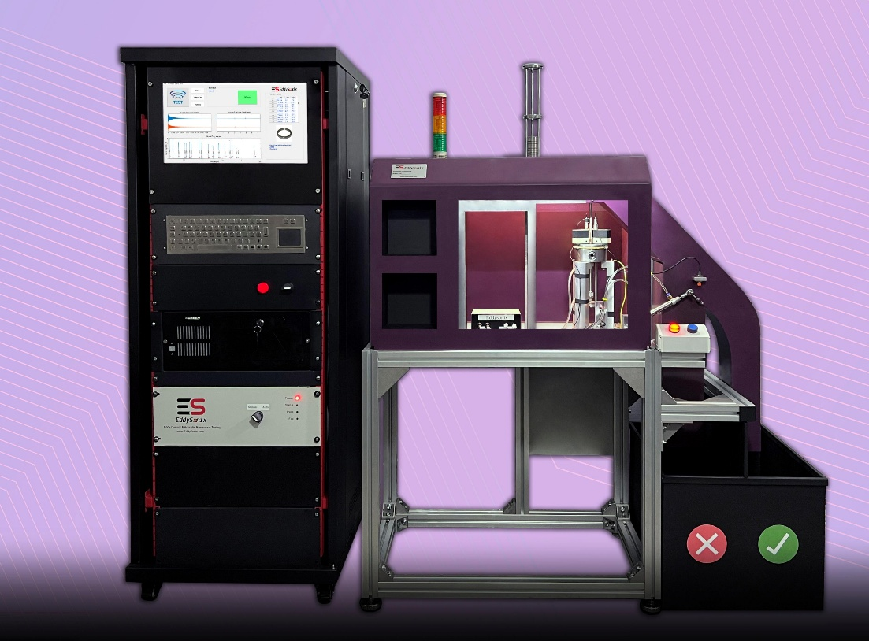
Custom-Designed Fixture, Automatic Part Feeder, and Sorting System
System Components:
  Feeder: Loads and positions parts automatically, enabling efficient batch processing.
  Test Fixture: Main testing unit where motorized probes align precisely with the component. Part holder retracts to allow free vibration, enabling 3-channel pickup for accurate mode capture.
  Sorting Module: Automatically separates ‘Good’ and ‘Bad’ parts into designated bins based on test results.
Custom Design Capabilities:
  We custom-design each component based on the part's geometry, supporting a family of parts with varying sizes but similar shapes.
Notes:
Our ARS system includes a custom feeder, test fixture, and sorting module, each tailored to the part’s geometry.
The feeder loads and positions parts automatically for efficient batch processing. In the test fixture, motorized probes align precisely, and the part holder retracts to allow free vibration, using a 3-channel pickup for accurate data capture. Finally, the sorting module directs parts into ‘Good’ and ‘Bad’ bins based on test results, ensuring streamlined quality control.
This setup can support a family of parts with similar shapes in different sizes, making it adaptable and efficient.

Slide 18

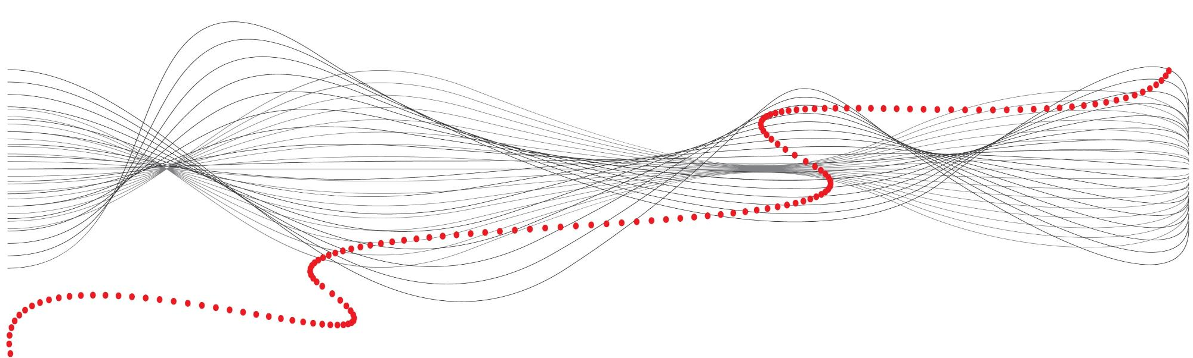
We appreciate your time and interest in EddySonix’s innovative solutions for precision defect detection.
Notes:
Thank you for your time and attention. At EddySonix, we’re dedicated to advancing non-destructive testing technology to meet the highest standards in precision and reliability. If you have any questions or would like to learn more about how ARS technology can support your specific needs, please don’t hesitate to reach out.

