Slide 1

Industrial Technologies and Processes
Acoustic Resonance Testing (ARS/ARI) for
Non-Destructive Evaluation of Cast and Advanced
Manufactured Metal Components
Hooman Dejnabadi
EddySonix, Orbe, Switzerland
Notes:
Good morning. My name is Hooman Dejnabadi, from EddySonix in Switzerland. Today I will present our acoustic resonance testing platform, using Sweep and Impact, for non-destructive evaluation of cast and advanced manufactured metal components.
The focus is the measurement principle, the shared analysis workflow, and some validation examples from industrial applications.

Slide 2
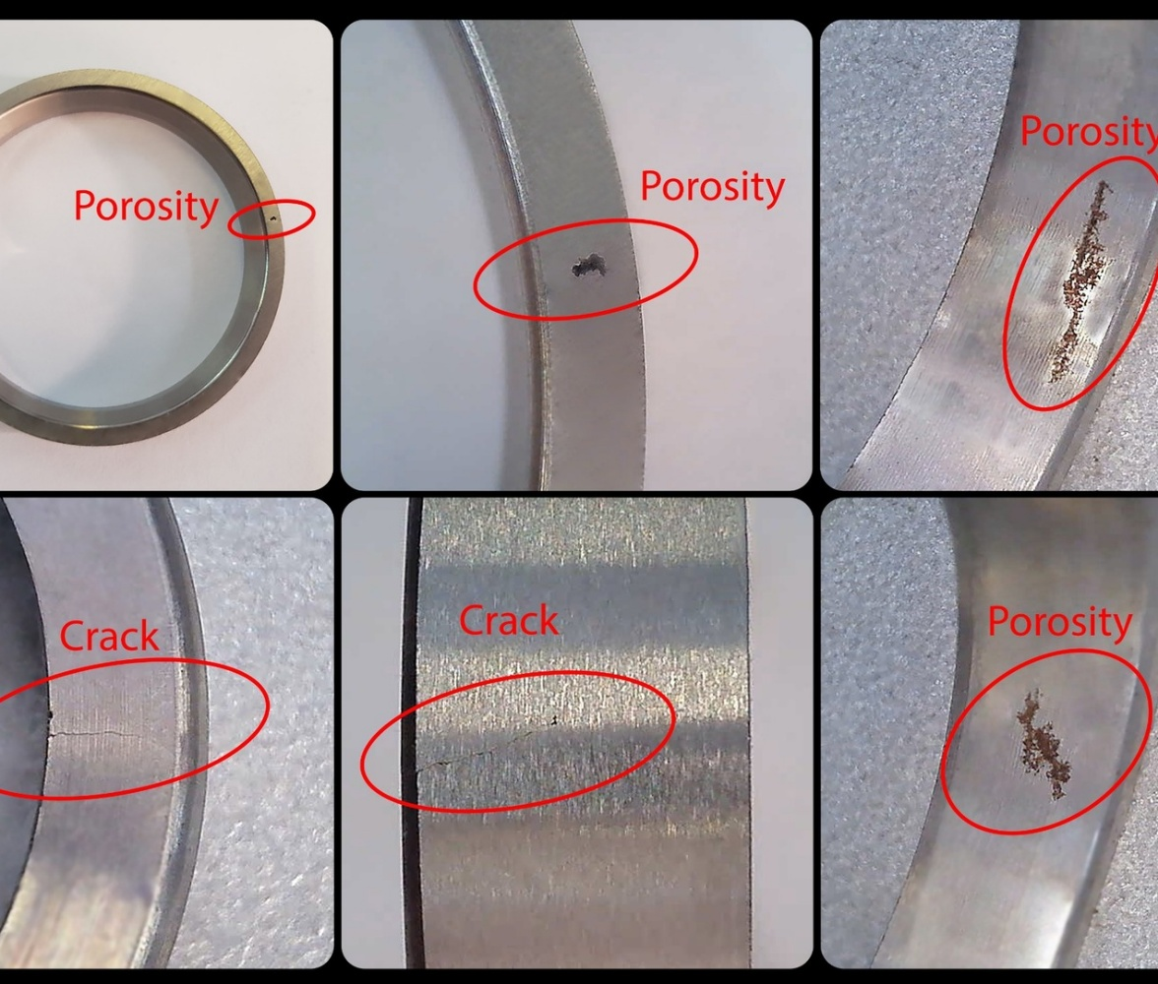
Inspection Challenge for Cast and Advanced Manufactured Parts
Manufacturing families
Casting
PM
MIM
AM
Typical quality risks
Cracks, voids, shrinkage, cold shut / lack of fusion
Low nodularity or microstructure variation
Local geometry or density deviation
Production requirement
Fast, repeatable, non-destructive inspection
Sensitive to the whole-body structural response
Traceable pass/fail output for routine quality assurance
Defects are often volumetric or structural, not only visual surface indications.
Key point: resonance testing evaluates the dynamic behavior of the complete component.
Acoustic Resonance Testing (ARS/ARI) | ECNDT 2026
2
Notes:
The main inspection challenge is that many defects are volumetric or structural. They are not always visible on the surface. This is important for castings, powder metallurgy parts, metal injection molded parts, and additive manufactured parts.
Typical problems include cracks, voids, shrinkage, lack of fusion, low nodularity, microstructure variation, and local geometry or density changes. The production need is a fast, repeatable, non-destructive inspection method. Acoustic resonance is useful because it evaluates the dynamic behavior of the complete component.

Slide 3
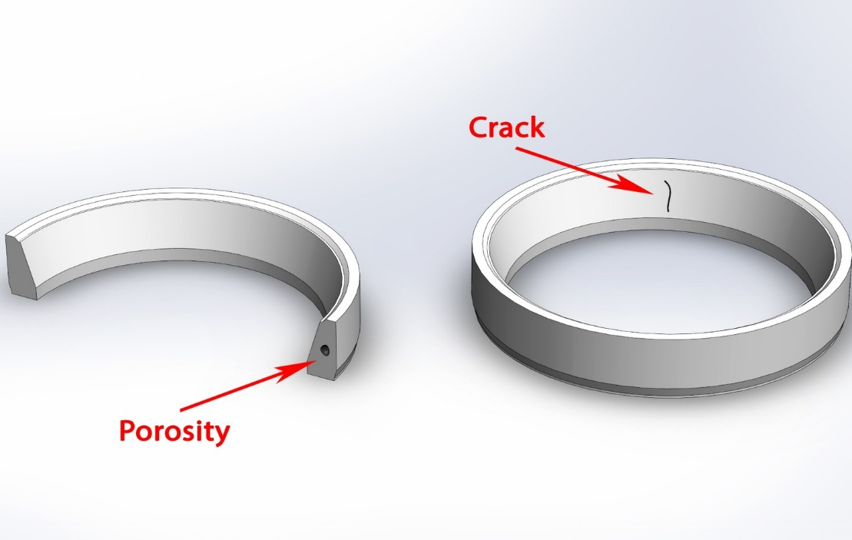
Resonance Principle: Defects Change the Modal Pattern
Whole-body response
The part vibrates according to its stiffness, mass distribution, damping, and boundary contact.
Modal changes
Cracks, voids, nodularity, and geometry deviations can shift frequencies or damping.
Excitation
Vibration response
Modal pattern
Pass / Fail
Important balance: ARS/ARI detects abnormal modal behavior; CT, X-ray, or destructive analysis may be used to confirm defect type or location.
Acoustic Resonance Testing (ARS/ARI) | ECNDT 2026
3
Notes:
The basic principle is simple. Every part has natural vibration modes. These modes depend on stiffness, mass, damping, and the boundary contact during testing.
If there is a crack, void, nodularity problem, or geometry deviation, some modal frequencies or damping values can change. The system detects this abnormal modal behavior. It is important to say that ARS and ARI detect abnormal structural response. CT, X-ray, or destructive analysis may still be used to confirm the exact defect type or location.

Slide 4
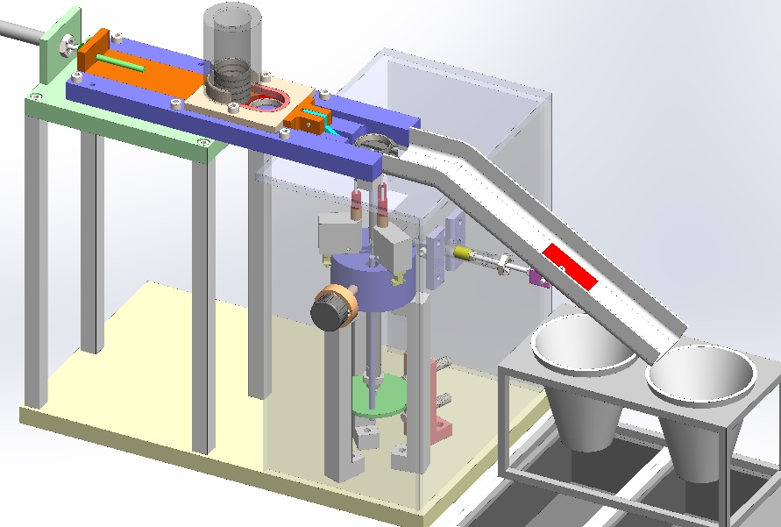
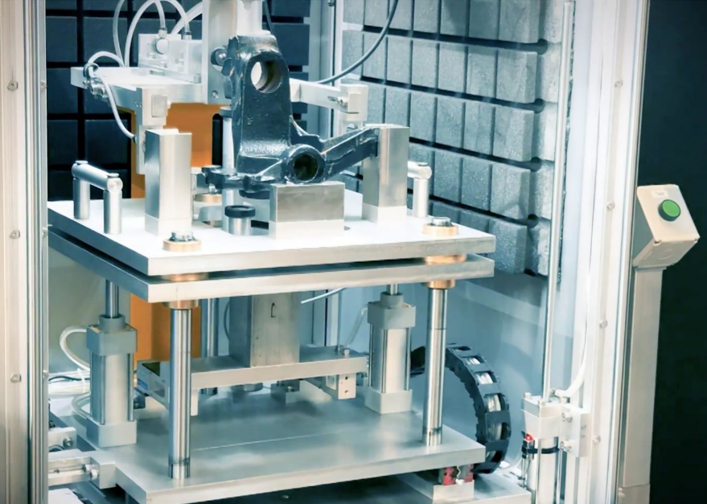
ARS and ARI: Two Excitation Modes, One Analysis Framework
Shared analysis
Mode fitting
Mode labelling
Feature extraction
Decision models
ARS — Acoustic Resonance Sweep
Controlled sweep excitation using a piezo actuator. Suitable for small PM, MIM, AM, and advanced manufactured components. Bandwidth up to 1 MHz depending on configuration.
ARI — Acoustic Resonance Impact
Mechanical impact excitation with microphone pickup. Suitable for large cast components such as calipers, knuckles, and other cast-iron parts.
Different mechanics; same modal-data workflow.
Acoustic Resonance Testing (ARS/ARI) | ECNDT 2026
4
Notes:
The platform uses two excitation methods. ARS, or Acoustic Resonance Sweep, uses a controlled piezo sweep. It is suitable for small, advanced manufactured parts, where high-frequency modal information is needed. Depending on the configuration, the bandwidth can reach up to one megahertz.
ARI, or Acoustic Resonance Impact, uses mechanical impact and microphone pickup. It is suitable for large cast components, such as calipers, knuckles, and similar cast-iron parts. The mechanics are different, but the data workflow is the same: mode fitting, mode labeling, feature extraction, and decision models.

Slide 5
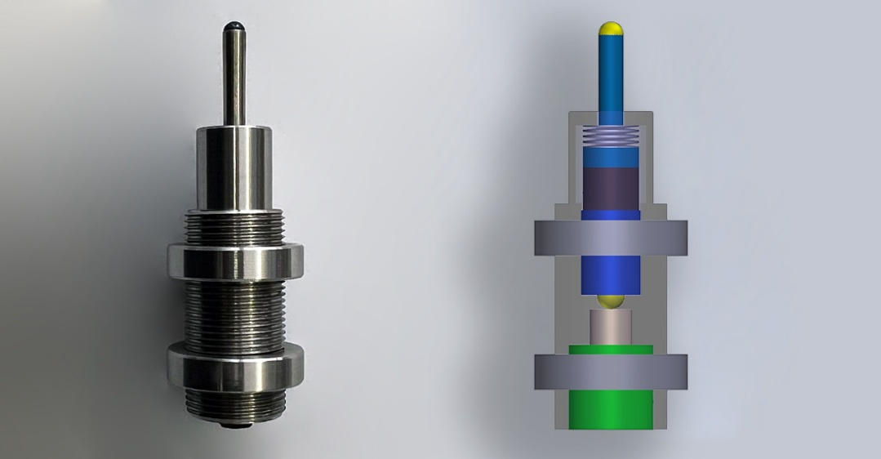
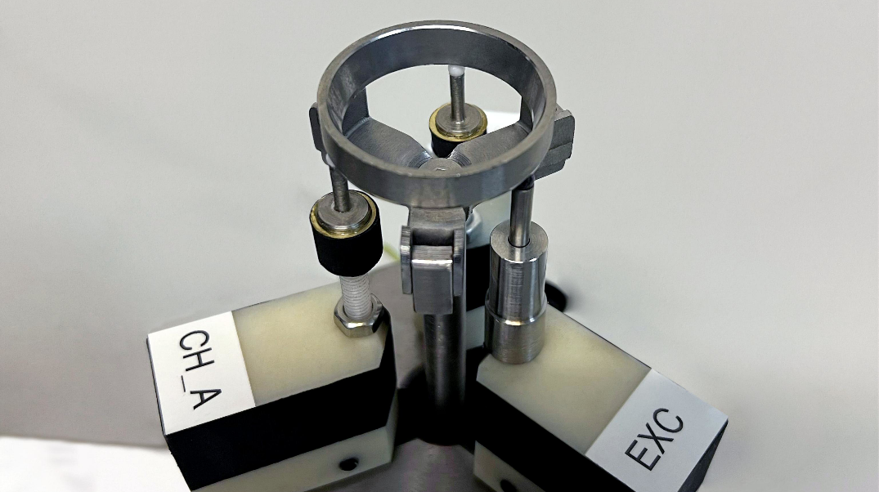
ARS Hardware: Sweep Excitation for Small Components
What ARS adds technically
Preloaded piezo actuator applies a controlled sweep to the part
Point-contact pickup sensors capture responses from multiple directions
The sweep signal is synthesized with controlled bandwidth, amplitude profile, and timing to obtain a clean frequency response.
High-frequency modal content is useful for small, lightweight parts
Repeatable contact and low-noise acquisition are part of the measurement method
Sweep input
Multi-channel response
Frequency response
ARS target: high-resolution modal information for small AM / PM / MIM and aerospace-type parts.
Acoustic Resonance Testing (ARS/ARI) | ECNDT 2026
5
Notes:
This slide shows the ARS hardware concept. A preloaded piezo actuator applies a controlled sweep to the part. One or more point-contact pickup sensors record the response.
The sweep is not just a simple sine sweep. It is synthesized with controlled bandwidth, amplitude profile, and timing, so that we obtain a clean frequency response. For small, stiff, lightweight components, high-frequency modal content is important. Repeatable contact and low-noise acquisition are therefore part of the measurement method.

Slide 6
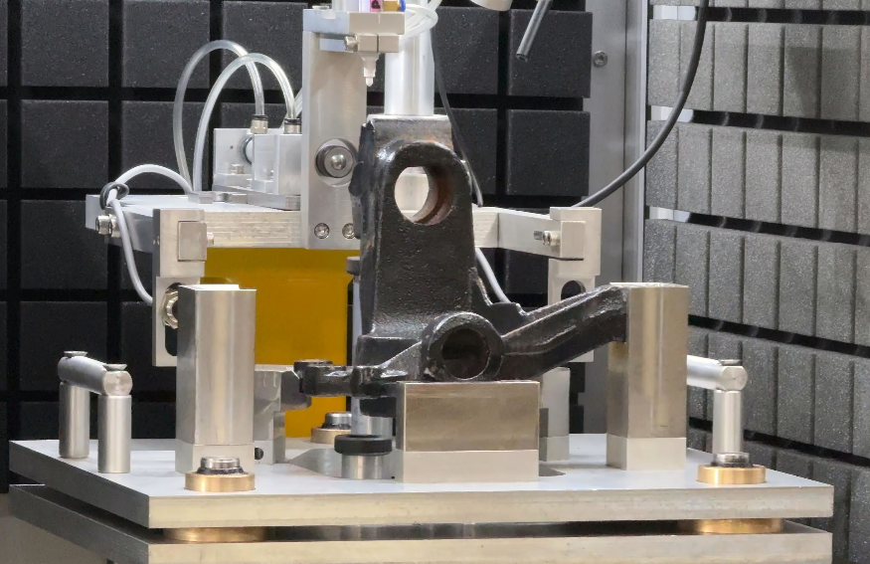
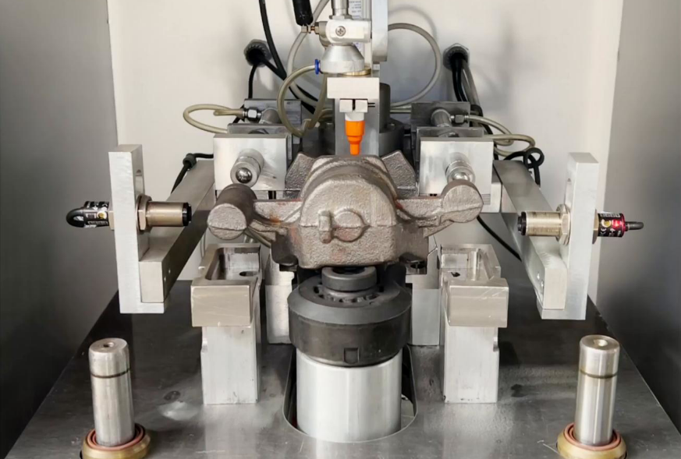
ARI Hardware: Impact Excitation for Large Castings
Why impact excitation is useful
Mechanical impact excites many low-frequency modes quickly
Microphone pickup avoids direct sensor contact on large cast parts
Suitable for cast-iron components with nodularity or casting-integrity requirements
Fast acquisition supports routine production inspection
Temperature and part mass are recorded during testing and used to compensate normal production variation
ARI application domain
Large cast iron parts: brake calipers, knuckles, engine handles, and similar components
Detected responses
Changes related to low nodularity, cold shut, shrinkage, cracks, and geometry deviation
ARI target: fast whole-body resonance response for large cast components.
Acoustic Resonance Testing (ARS/ARI) | ECNDT 2026
6
Notes:
For large castings, impact excitation is more practical. A mechanical impact excites many low-frequency modes quickly. The microphone pickup avoids direct sensor contact on large cast parts.
This is useful for cast-iron components where the quality requirement is related to nodularity or casting integrity. Changes related to low nodularity, cold shut, shrinkage, cracks, or geometry deviation can change the modal response. Temperature and part mass can also be recorded and used to compensate normal production variation.

Slide 7
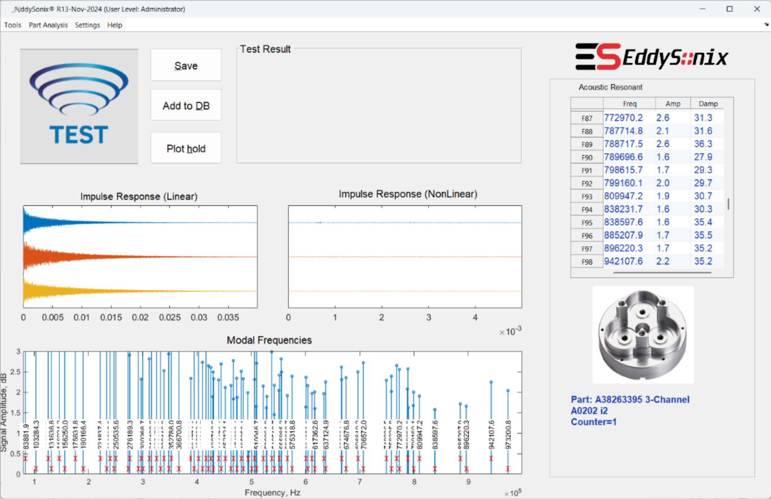
Unified Analysis Workflow
Common software platform
Part Programs and reference databases are used for each component type
Database creation, training, criteria, decision, reporting, and Batch Test follow the same philosophy as EddySonix eddy current systems
This common workflow reduces operator training and keeps engineering tools consistent across NDT methods
Excitation
Response
Transfer function
Mode fitting
Mode labelling
Features
Decision
The same processing chain is used after ARS sweep or ARI impact acquisition.
Acoustic Resonance Testing (ARS/ARI) | ECNDT 2026
7
Notes:
After excitation, both ARS and ARI follow the same analysis chain. The system records the response, calculates the transfer function, fits the modes, labels them, creates features, and then applies decision criteria.
This common workflow is an important advantage. The same EddySonix software philosophy is used for part programs, reference databases, training, criteria, reports, and Batch Test. This reduces operator training and keeps the engineering workflow consistent across different NDT methods.

Slide 8
Mode Fitting: Beyond Simple Peak Detection
Why peak picking is not sufficient
Modes can be weak, close, overlapping, or distorted by noise
A peak maximum is not always the true modal frequency
Dense high-frequency spectra require physical mode models
What the fitting algorithm estimates
Frequency
Modal position
Damping
Modal width / loss
Amplitude
Fitted, not primary diagnostic feature
Key novelty: fitted modal parameters are more stable than raw peak positions in dense spectra.
Acoustic Resonance Testing (ARS/ARI) | ECNDT 2026
8
Notes:
A key technical point is that the system does not rely only on simple peak picking. Peak picking can fail when modes are weak, close together, overlapping, or affected by noise. Also, the highest point of a peak is not always the true modal frequency.
The fitting algorithm estimates modal frequency, damping, and amplitude using a physical mode model. For the final decision, frequency and damping are the main diagnostic features. Amplitude is fitted, but it is not the primary diagnostic feature. This gives more stable modal parameters in dense spectra.

Slide 9
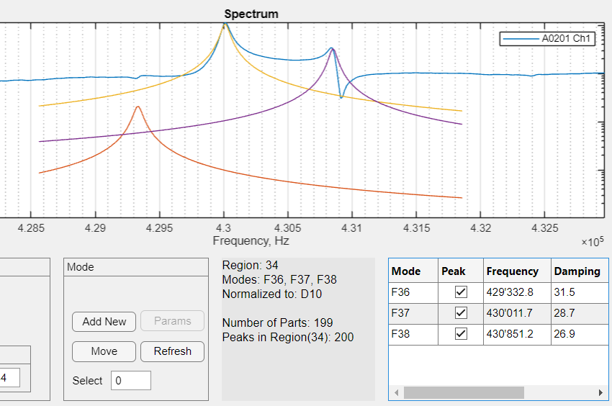
Multi-Channel Fitting and Stable Mode Labeling
Multi-channel value
A single pickup can miss a mode near a nodal region
Several channels confirm real modes and reduce channel-specific artefacts
Mode fitting uses information from all available channels
Labeling is not cosmetic
Each fitted mode receives a stable index: F1, F2, ..., Fn
If F51 is mislabeled as F50, ratios and multivariate decisions become wrong
The number of useful modes depends on geometry and defect sensitivity requirement
Stable labels enable meaningful comparison from part to part, even with tens to several hundred modes.
Acoustic Resonance Testing (ARS/ARI) | ECNDT 2026
9
Notes:
Multi-channel acquisition improves confidence. A single pickup can miss a mode if the sensor is close to a nodal region. Several channels help confirm real modes and reduce channel-specific artefacts.
Stable mode labeling is also essential. Each fitted mode must keep the correct label, such as F1, F2, and so on. If, for example, F51 is mislabeled as F50, then the ratios and multivariate decisions become wrong. Depending on the part geometry, the useful mode count may be small, or it may reach tens or several hundred modes.

Slide 10
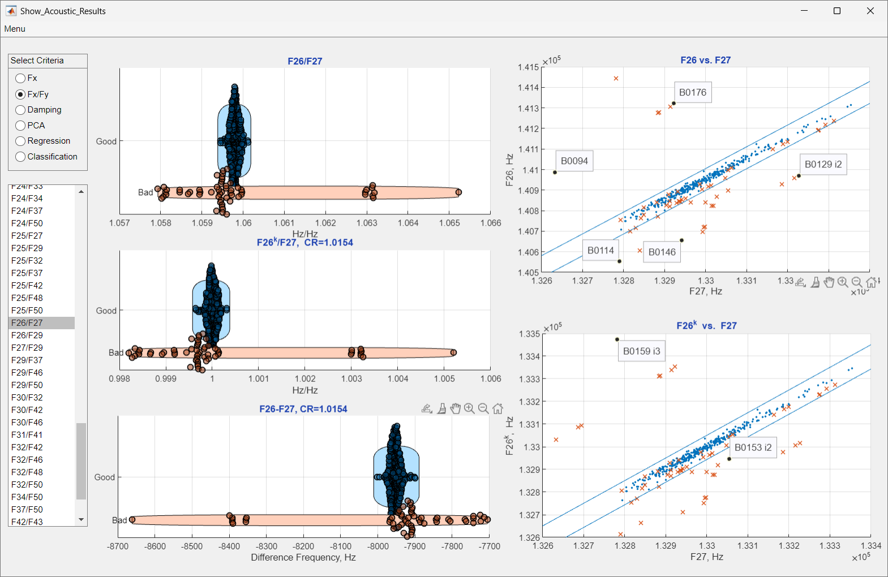
Feature Extraction: Frequencies, Damping, and Ratios
Primary diagnostic features
Frequencies
mode shifts due to stiffness, density, geometry, or structural defects
Damping
increase due to cracks or low nodularity in selected modes
Why frequency ratios are useful
A single mode may remain within limits while relationships between modes change
Selected Fx/Fy ratios reduce common-mode variation such as temperature or mass shift
With many modes, thousands of Fx/Fy ratios are possible; the software selects the most relevant ratios automatically
Normal parts keep modal harmony; local defects or structural anomalies disturb selected relationships.
Acoustic Resonance Testing (ARS/ARI) | ECNDT 2026
10
Notes:
The main diagnostic features are modal frequencies, damping factors, and selected frequency ratios. Frequencies can shift because of stiffness, density, geometry, or structural defects.
Damping is also useful. In our applications, cracks and low nodularity often increase damping in selected modes.
Frequency ratios are important because one individual mode may still be inside its limit, while the relationship between modes changes. In a good part, the modes remain in harmony. A local defect can disturb this harmony. When many modes are available, thousands of ratios are possible, so the software selects the most relevant ratios automatically.

Slide 11
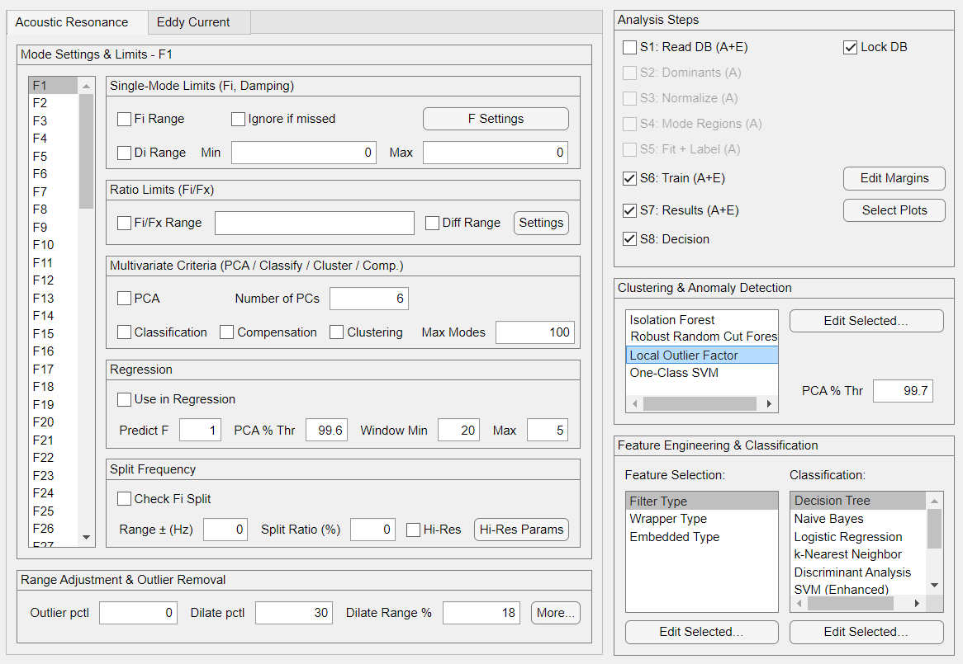
Decision Framework and Anomaly Detection
Decision layers
Single-variable limits
Frequency ratios
PCA / Regression
Classifiers / ML
Anomaly detection
Shared EddySonix platform advantage
Part Programs, databases, criteria, reports, and Batch Test use the same workflow philosophy as ECS and ECF
Known defect classes can be classified; unknown abnormal behavior can be flagged for review
The final output is a controlled quality decision, not black-box AI
Acoustic Resonance Testing (ARS/ARI) | ECNDT 2026
11
Notes:
The final decision can use several layers. The simplest layer is a single-variable limit. Then we can add frequency ratios, PCA, regression, classifiers, machine learning, and anomaly detection.
If known defect classes are available, they can be classified. If the defect type is unknown, the system can flag abnormal behavior for review. The important point is that the output is a controlled quality decision based on a database and defined criteria. It is not black-box AI.

Slide 12
ARI Result: Cast-Iron Nodularity and Casting Defects
Training set
200 good cast-iron parts
collected over 2 months
Criteria applied | Low nodularity (n=100) | Other casting defects (n=56)
Frequency limits only | 100 / 100 | 46 / 56 (82%)
+ ratios, frequency differences, and power-law relations | 100 / 100 | 53 / 56 (95%)
+ PCA and frequency prediction | 100 / 100 | 56 / 56 (100%)
Independent test set
500 good parts
100 low-nodularity parts
56 other casting defects
Analysis
17 modal frequencies
+ multivariate criteria
Key point: single-frequency limits were not sufficient for random casting defects; multivariate modal criteria removed the remaining overlap.
Dataset-specific result; each new component family still requires its own reference database and validation.
Acoustic Resonance Testing (ARS/ARI) | ECNDT 2026
12
Notes:
This slide shows one ARI result on cast-iron parts. The training set included 200 good cast-iron parts collected over two months. The independent test set included 500 good parts, 100 low-nodularity parts, and 56 parts with other casting defects.
Using frequency limits alone, the system detected all low-nodularity parts, but some random casting defects still overlapped with the good population. When frequency ratios were added, the result improved. With PCA and frequency prediction, all defective parts in this dataset were separated. This result is dataset-specific, so each new component family still needs its own reference database and validation.

Slide 13
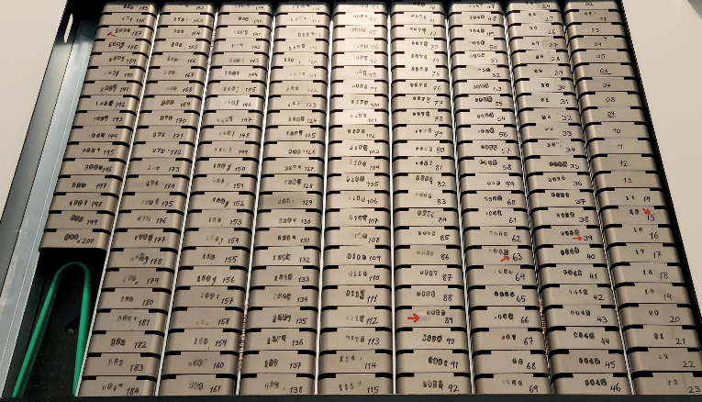
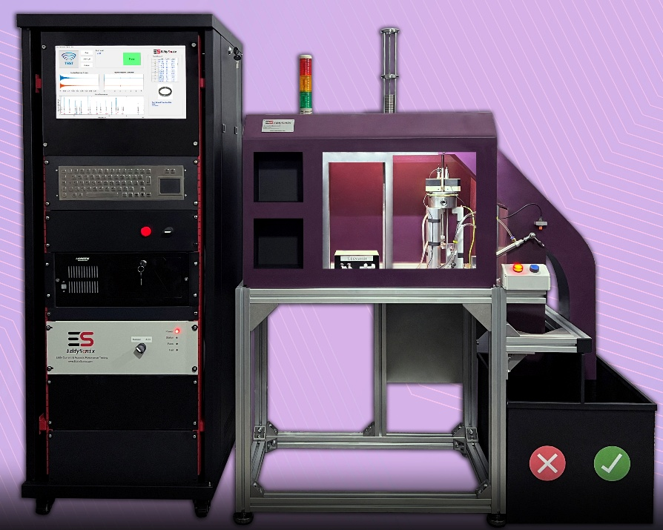
ARS Result: Small Advanced-Manufactured Parts
Aerospace Ti alloy MIM validation
≈800 Ti alloy samples tested
sample weight around 50 g
defective samples rechecked by CT
cavities larger than 0.25 mm detected
Valve-seat PM production validation
small ring components around 8 g
routine production: >2,000 parts/day
500-sample cracks and cavities confirmed by X-ray
X-ray-defective samples were identified by ARS
Common ARS output: Go / No-Go decision, frequency and damping features, database-driven criteria, traceable results; production cells can include automatic feeding, loading, and sorting. Typical sweep: 5–10 s.
Acoustic Resonance Testing (ARS/ARI) | ECNDT 2026
13
Notes:
This slide shows two ARS validation examples for small advanced-manufactured parts.
In the first aerospace Ti alloy MIM study, about 800 samples were tested. The samples were around 50 grams, and suspect parts were rechecked by CT. In this application, cavities larger than about 0.25 millimeter were detected.
The second example is valve-seat production testing. These are small powder metallurgy ring components, around 8 grams. The system is used in routine production for more than 2,000 parts per day. Cracks and cavities were confirmed by X-ray, and X-ray-defective samples were also identified by ARS.
The common output is a Go / No-Go decision based on frequency, damping, and database-driven criteria. In automated production cells, feeding, loading, and sorting can also be integrated. The typical sweep time is about 5 to 10 seconds.

Slide 14
Boundary Conditions and Conclusions
Boundary conditions
Conclusions
Reference database required for each part family
Defect must change the modal response enough to be separable
CT, X-ray, or destructive analysis may be used to confirm defect type or location
Dual excitation: ARS serves high-frequency small components; ARI serves large cast components.
Unified modal framework: Both modes use acquisition, mode fitting, mode labeling, feature extraction, and decision models.
Production-oriented NDT: The method supports routine non-destructive quality assurance for cast and advanced manufactured metal parts.
Key technical contribution: multi-channel mode fitting, stable mode labeling, selected modal ratios, and statistical / ML-based evaluation.
Thank you
Acoustic Resonance Testing (ARS/ARI) | ECNDT 2026
14
Notes:
To keep the method technically balanced, there are boundary conditions. A reference database is required for each part family. The defect must change the modal response enough to be separated from normal production variation. Also, CT, X-ray, or destructive analysis may be needed to confirm defect type or location.
The conclusion is that ARS and ARI use different excitation methods, but they share one modal-analysis framework. The key contribution is multi-channel mode fitting, stable mode labeling, selected modal ratios, and statistical or machine-learning-based evaluation. Thank you for your attention.

