Slide 1

Industrial Technologies and Processes
Eddy Current Scanner for Case Depth Measurement of Induction-Hardened Axle Bars and Stem Shafts
Dr. Hooman Dejnabadi
EddySonix, Orbe, Switzerland
Notes:
Good morning.
My name is Hooman Dejnabadi from EddySonix in Switzerland.
Today I will present our Eddy Current Scanner, or ECS, for Non-Destructive case depth measurement of induction-hardened axle bars and stem shafts.
The main focus is how this system can replace routine destructive cut-check verification.

Slide 2
Objective: Replacing Routine Destructive Cut-Checks
Current quality practice
Industrial impact
OEM protocols require periodic ECD cut-checks
Triggers may include time interval, induction coil change, part-type change, or process adjustment
Complex stems may require many cross-section and longitudinal measurements
Each checked part is destroyed
Cutting, preparation, and microhardness testing are slow and costly
The process consumes material, energy, and laboratory resources
ECS strategy: run ECS and cut-checks in parallel during validation, prove agreement statistically, then reduce or eliminate routine cut-checks.
OEM cut-check protocol
Parallel ECS + cut-check validation
Routine ECS-based ECD verification
Eddy Current Scanner (ECS) | ECNDT 2026
Notes:
The industrial problem is the routine cut-check.
OEM protocols require ECD verification at fixed intervals, after coil changes, after part-type changes, or after process adjustments. These cut-checks are accurate, but each tested part is destroyed. For complex stems, several cross-section and longitudinal measurements may be required. This takes time, material, energy, and laboratory work. Our goal is to run ECS and cut-checks in parallel during validation, prove the agreement statistically, and then reduce or eliminate routine destructive checks.

Slide 3
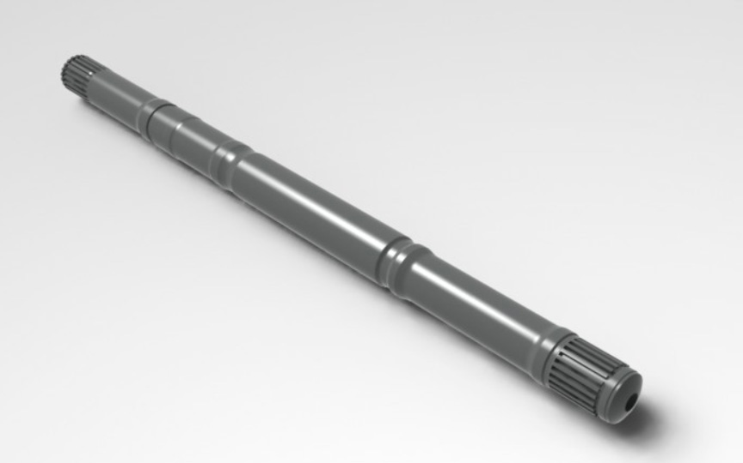
Application Geometry: Axle Bars and Stem Shafts
Representative shaft geometry
Inspection challenge
• Splines, shoulders, grooves, and diameter transitions
• ECD may be specified at axial and angled locations
• Local eddy-current response changes strongly with coil position
• Full-length scanning gives synchronized data for each control point
Example axle/stem shaft with splines, shoulders, grooves, and diameter transitions
Key message: complex shaft geometry is why ECS uses controlled full-length scanning, not fixed point measurement.
Eddy Current Scanner (ECS) | ECNDT 2026
Notes:
This slide shows a representative shaft geometry. These parts are not simple cylinders. They include splines, shoulders, grooves, and diameter transitions. ECD can be specified at several axial locations, and sometimes at angled locations. In these areas, the eddy-current response changes strongly with coil position. This is why fixed point measurement is not enough. ECS uses controlled full-length scanning to keep all control points synchronized with the part geometry.

Slide 4
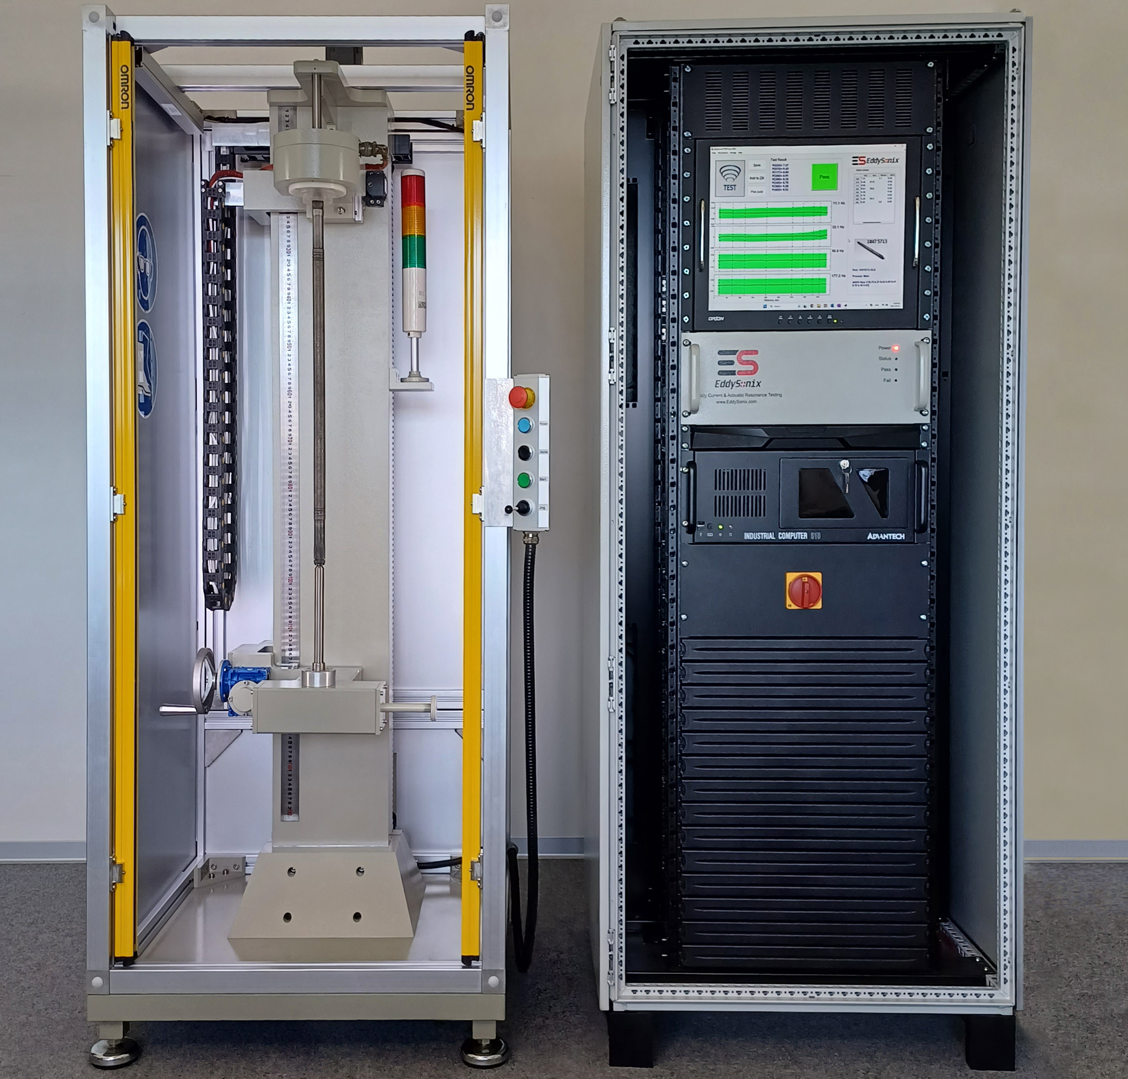
EddySonix ECS System Overview
From controlled scan to non-destructive ECD verification
Part clamped between centers
Coil scans along the axis
Multi-frequency impedance recorded continuously
Part loaded
Coil scan
Signal analysis
ECD results
Routine output
Numerical ECD values at OEM-defined locations, alarm/pass-fail decision, and traceable reports in a test cycle below 30 seconds.
Eddy Current Scanner (ECS) | ECNDT 2026
Notes:
Here is the ECS system overview. The part is clamped between centers, and the coil scans along the axis of the part. During the scan, the system records multi-frequency impedance continuously. Then the software calculates numerical ECD values at OEM-defined locations. The output includes ECD values, alarms, pass-fail decision, and traceable reports. The complete test cycle is below 30 seconds.

Slide 5
Measurement Physics: Frequency Roles in ECS
Induction-hardened shaft structure
Why multiple frequencies are required
hardened case
Low frequencies carry ECD information; high frequencies measure surface response and compensate surface effects.
softer core
Applied ECS frequencies and roles
5
10
20
40
80
160
320
Primary ECD estimation
Intermediate
Surface response band
Deep penetration for approx. 3 to 10 mm ECD
Transition
Surface hardness measurement + surface-effect compensation for ECD
Amplitude and phase are evaluated together in the impedance plane at each selected frequency.
Final ECD estimate = low-frequency case/core response corrected by high-frequency surface information
Eddy Current Scanner (ECS) | ECNDT 2026
Notes:
The physics is based on the interaction between the hardened case and the soft core. We use several frequencies because one frequency cannot separate all effects. The low frequencies, mainly 5, 10, and 20 hertz, carry the main ECD information and penetrate deeply enough for about 3 to 10 millimeters case depth. The higher frequencies, above 80 hertz, are used for surface hardness, and compensation of surface effects. Amplitude and phase are interpreted together in the impedance plane.

Slide 6
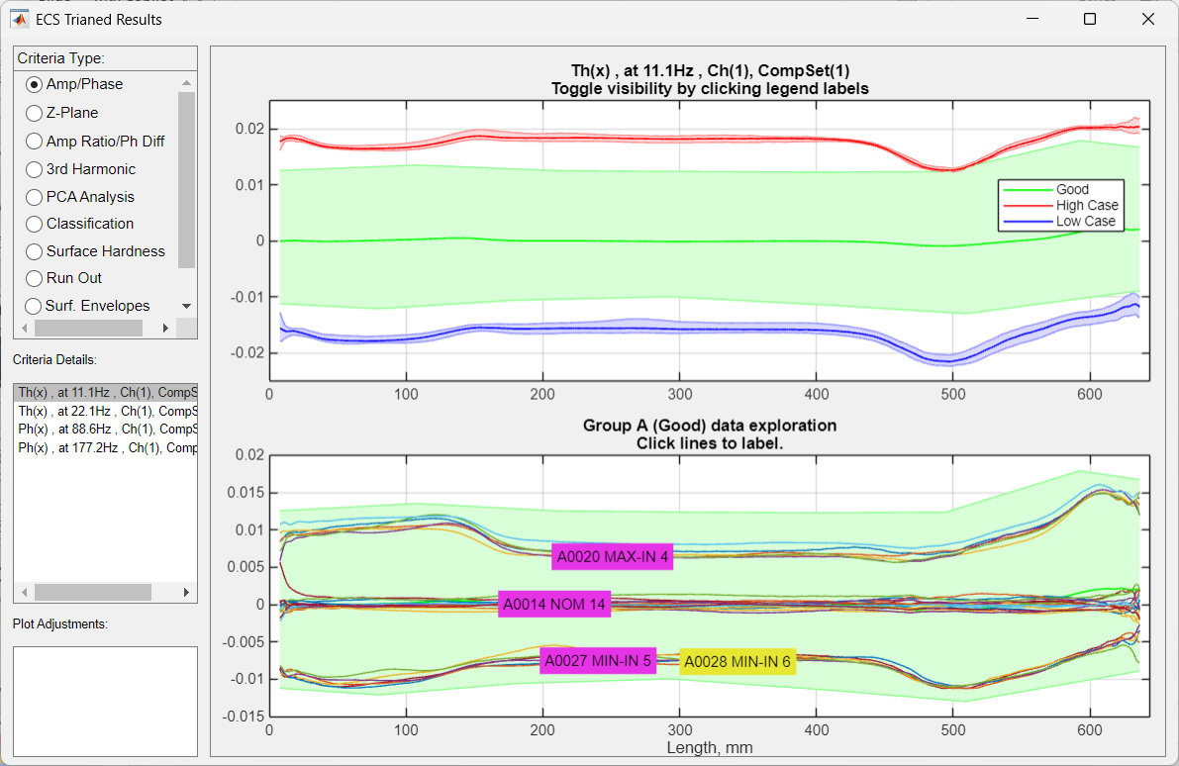
Continuous Scan Envelopes Along the Full Shaft
What the scan creates
Full-length envelope
Master alignment
OEM-defined ECD points
Scientific point
The scan generates a full ECD-related envelope, not only an isolated local reading.
Eddy Current Scanner (ECS) | ECNDT 2026
Notes:
The scan creates continuous envelopes along the full shaft. This is a key difference from point-only eddy-current testing. The system aligns the scanned part with the master reference, then extracts the response at OEM-defined ECD points. Because the coil scans the full length, we also see how the signal behaves before and after each control point. This gives much richer information than a single local reading.

Slide 7
From Cut-Check References to a Permanent ECD Model
Reference parts
Nominal, Min/Max-In, Min/Max-Out
Destructive anchor
Microhardness ECD at OEM-defined locations
ECS training
Multi-frequency envelopes linked to ECD
Locked ECD model
No periodic recalibration after validation
Transition strategy: run ECS and cut-checks in parallel for about one month, compare results statistically, then reduce or cancel routine destructive cut-checks.
Eddy Current Scanner (ECS) | ECNDT 2026
Notes:
The model is anchored to real destructive data. We start with reference parts: Nominal, Min, and Max case-depth levels. These parts are cut-checked, and the true microhardness ECD values are entered at the required locations. ECS then links the multi-frequency envelopes to these ECD values. After training and validation, the model is locked. There is no periodic recalibration. The transition strategy is to compare ECS and cut-checks for a validation period, then replace routine cut-checks with ECS verification.

Slide 8
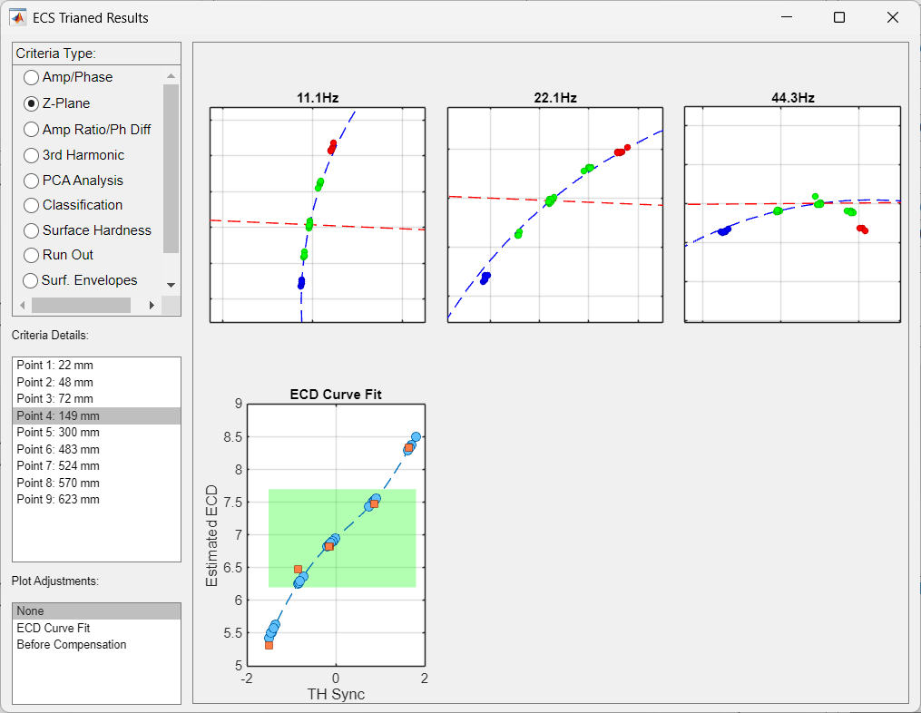
Impedance Plane and Theta Transformation
At each inspection point
Parts with different ECDs form loci in the complex impedance plane.
The arc is fitted and converted to a Theta angle
Theta is normalized so Nominal references are centered near zero
Selected Thetas are combined into a single ECD-related variable
A constrained curve fit maps Theta to microhardness ECD values
This is the step that converts EC amplitude/phase data into a physically useful ECD estimate anchored to cut-check values.
Eddy Current Scanner (ECS) | ECNDT 2026
Notes:
At each inspection point, parts with different case depths “form” loci in the complex impedance plane. Instead of using raw amplitude or phase alone, the system fits this locus and converts the position into a Theta angle. The Theta values are normalized so nominal references are centered near zero. Selected Thetas from different frequencies are then combined and mapped to microhardness ECD values. This step converts raw EC amplitude and phase data into a useful ECD estimate.

Slide 9
Compensation Enables Calibration-Free Use
The algorithm separates true ECD variation from normal production effects in the raw eddy-current signals.
Raw signal sensitivity
heat code / alloy
part temperature
residual magnetism
surface hardness
Compensation stages
Stable ECD output
ECD values at OEM-defined points
pass/fail and alarm limits
traceable reports
no periodic recalibration after validation
1. Material / temperature
amplitude and phase stabilization
2. Surface correction
high-frequency data reduce surface influence
3. Local-resolution correction
restores peaks and valleys near geometry transitions
Practical result: after training and validation, new heat codes inside the validated production range do not require a new calibration.
Eddy Current Scanner (ECS) | ECNDT 2026
Notes:
Raw eddy-current signals are sensitive to heat code, alloy variation, part temperature, residual magnetism, and surface hardness. Traditional eddy-current methods often need recalibration when material batches change. In ECS, the compensation framework separates these unwanted effects from the true ECD variation. Material and temperature effects are stabilized, surface effects are corrected using high-frequency data, and local-resolution correction restores peaks and valleys near geometry transitions. This is why the trained model remains valid without periodic recalibration, as long as production stays inside the validated range.

Slide 10
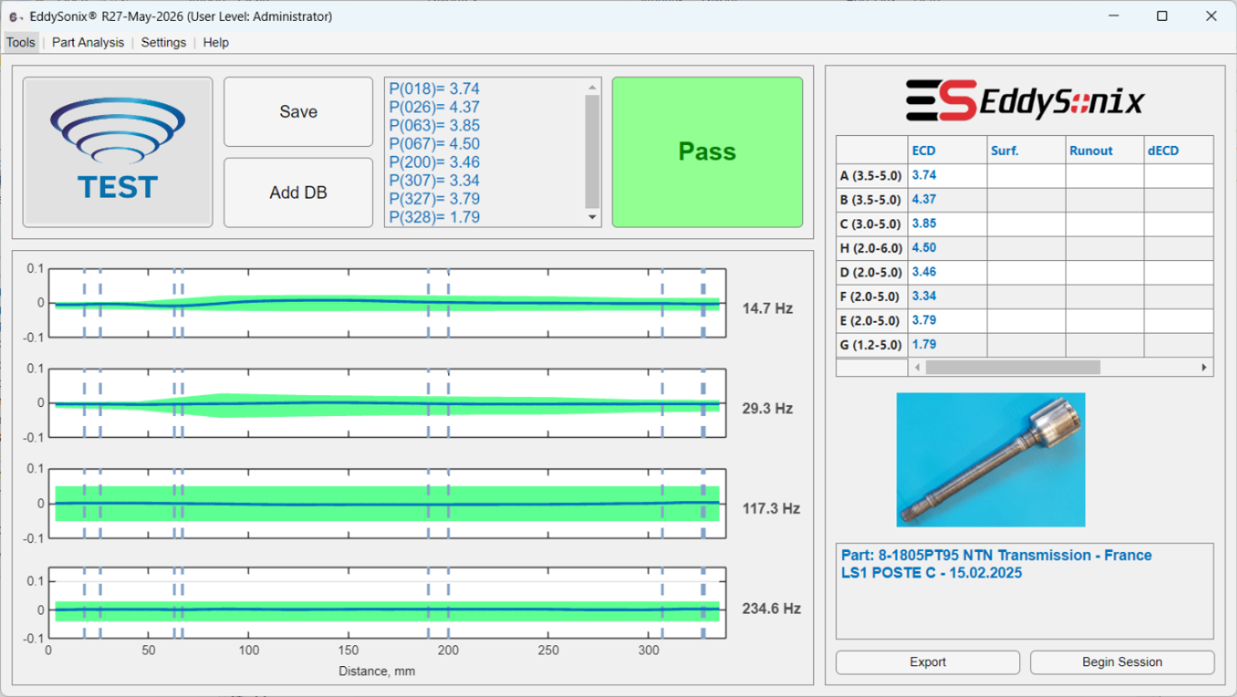
Routine ECD Verification Workflow
The main screen reports ECD values, alarms, and pass/fail decision at the required locations.
ECS is used at the same verification rhythm as routine cut-checks
Test triggers may include time interval, coil change, part-type change, or process adjustment
Results are non-destructive and traceable for quality records
Detailed plots remain available for engineering review
<30 s test cycle
up to 20 ECD points
P/F decision
Eddy Current Scanner (ECS) | ECNDT 2026
Notes:
After validation, ECS is used at the same verification rhythm as the former cut-checks. The trigger can be time interval, induction coil change, part-type change, or process adjustment. The difference is that the part is no longer destroyed. The operator gets ECD values, alarms, pass-fail decision, and traceable quality records. Detailed plots are still available for engineering review when needed.

Slide 11
Validation Against Microhardness
Validation principle
ECS and cut-checks run in parallel; ECS estimates are compared point-by-point with microhardness results.
0.15 mm typical standard deviation
0.3 mm maximum deviation
Includes nominal, high-case, and low-case conditions
Agreement is evaluated per defined cut-check location
Statistical agreement is used to justify reducing or canceling routine cut-checks
Eddy Current Scanner (ECS) | ECNDT 2026
Notes:
Validation is done by running ECS and cut-checks in parallel. For each production part, ECS estimates are compared point-by-point with microhardness results. Across several part families, we typically observe about 0.15 millimeter standard deviation and a maximum deviation around 0.3 millimeter. The validation includes nominal, high-case, and low-case conditions. This statistical agreement is the basis for reducing or cancelling routine destructive cut-checks.

Slide 12
Transition Plan: From Cut-Checks to ECS Verification
Controlled transition workflow
DB setup
Parallel ECS + Cut
30-50 parts
Statistical proof
Cut-check reduction
Typical transition uses production parts collected over several weeks
Batch Test reports RMSE, mean error, correlation, and Bland-Altman agreement
Batch Test supports supervised fine-tuning to reduce bias, RMSE, and standard deviation
After agreement is accepted, routine destructive checks can be strongly reduced or removed under the customer quality protocol.
Eddy Current Scanner (ECS) | ECNDT 2026
Notes:
The transition must be controlled. In a typical case, production parts are collected over several weeks. We scan them with ECS, then cut-check them and compare the results. The Batch Test tool reports RMSE, mean error, correlation, and Bland-Altman agreement. It can also support supervised fine-tuning to reduce bias, RMSE, and standard deviation. However, this is not automatic self-learning. The database is not modified automatically, and the final decision remains under the customer quality protocol.

Slide 13
Performance, Long-Term Stability, and Boundary Conditions
Reported performance and use case
Boundary conditions
0.15 mm
typical std
0.3 mm
max. dev.
<30 s
test time
Validated reference database is required for each component family
Part orientation, coil selection, and scan parameters must remain controlled
New geometry or major process change requires a new setup or validation
Non-destructive replacement for periodic ECD cut-check verification
Long-term deployments show stable results without periodic recalibration
Traceable test files, PDF reports, and external export options
Can test more frequently if desired, but 100% sorting is not the primary use case
Technical balance
Microhardness remains the reference for setup and validation; ECS performs routine verification without destroying parts.
Eddy Current Scanner (ECS) | ECNDT 2026
Notes:
The practical performance is a typical standard deviation of 0.15 millimeter, maximum deviation around 0.3 millimeter, and test time below 30 seconds. Long-term deployments show stable results without periodic recalibration. But there are boundary conditions. A validated reference database is required for each component family. Part orientation, coil selection, and scan parameters must remain controlled. For a new geometry or major process change, a new setup or validation is required.

Slide 14
Conclusions
Cut-check replacement
Robust EC modeling
Validated long-term stability
A trained ECS model transfers destructive microhardness information into non-destructive routine ECD verification.
Multi-frequency scanning, Theta modeling, and compensation handle heat code, temperature, and residual magnetism effects.
Once trained and validated, the system operates without periodic recalibration and supports reduction or cancellation of routine cut-checks.
ECS is not presented as a generic eddy-current sorter. It is a validated non-destructive replacement for routine ECD cut-check verification.
Thank you
Eddy Current Scanner (ECS) | ECNDT 2026
Notes:
To conclude, ECS transfers destructive microhardness information into non-destructive routine ECD verification. The method combines multi-frequency scanning, Theta modeling, and “Compensation” to handle heat code, temperature, residual magnetism, and surface effects. Once trained and validated, the system operates without periodic recalibration and supports strong reduction, or cancellation, of routine cut-checks. ECS is not presented as a generic eddy-current sorter. It is a validated replacement for routine ECD cut-check verification.
Thank you for your attention.

