Slide 1
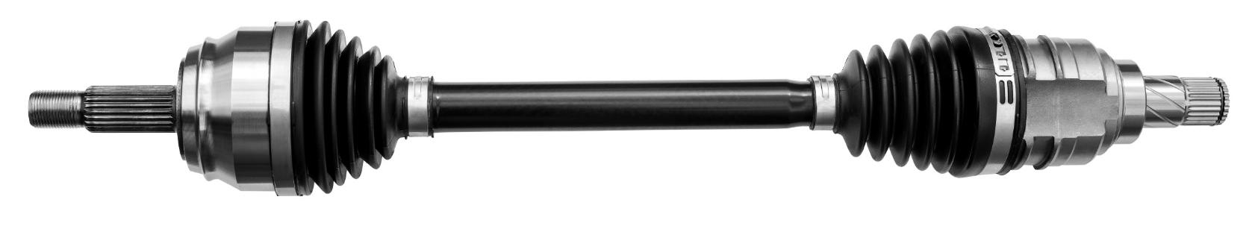
EddySonix ECS Technology: Redefining Precision in Non-Destructive Case Depth Measurement
Advanced NDT Solutions for High-Precision Automotive Components
Powered by Eddy Current Scanner (ECS) Technology
Notes:
Welcome to the EddySonix ECS presentation. The EddySonix ECS, an advanced Eddy Current Scanner, revolutionizes non-destructive testing for automotive axle bars. Delivering fast, accurate, and reliable case depth measurements without destructive methods, ECS has been trusted by industry leaders since 2017. It addresses key challenges like material variation and production consistency, combining cutting-edge technology with robust design to set a new standard in automotive quality assurance.

Slide 2
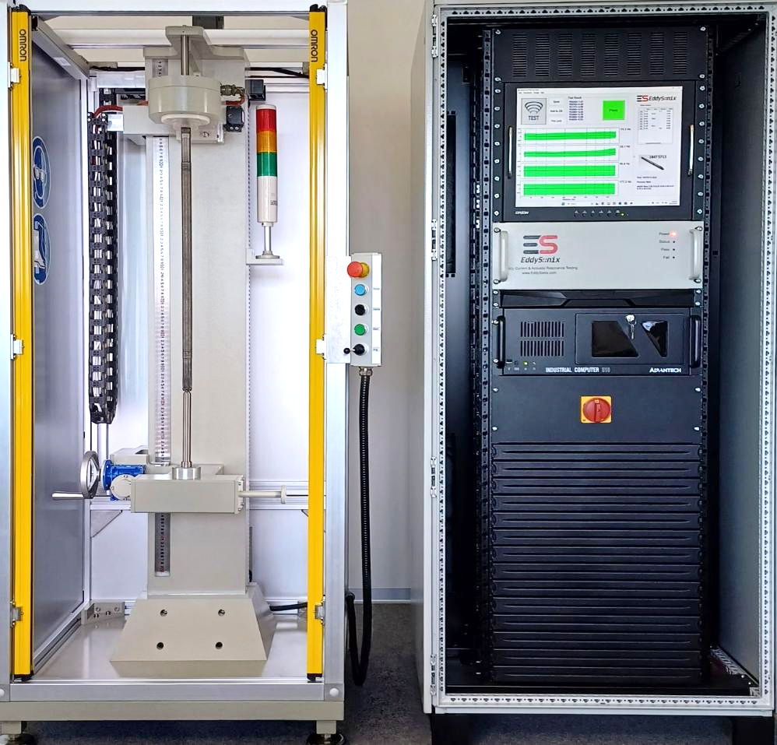
The ECS System: Built for Precision and Reliability
Advanced Eddy Current Scanner Technology:
  Precision, speed, and robustness tailored for the automotive industry.
Globally Trusted:
  Reliable performance with industry leaders worldwide since 2017.
Unmatched Accuracy:
  Non-destructive testing delivering precise, consistent results.
Robust Design:
  Industrial-grade durability with zero operational failures.
Certified Standards:
  Compliant with global safety and performance certifications.
Notes:
Here is the ECS system, the core of non-destructive case depth measurement. Trusted by industry leaders since 2017, it delivers unmatched accuracy and durability. Engineered with industrial-grade components, it boasts a zero-failure record even in demanding environments. Fully compliant with global safety and quality standards, ECS is the trusted choice for manufacturers worldwide.

Slide 3
ECS Global Reach: Trusted by Industry Leaders Worldwide
Deployed by top automotive manufacturers since 2017.
Proven reliability with installations in major global regions.
Zero-failure record across all operations.
ECS Deployment Locations: Precision and Reliability Across the Globe.
Notes:
ECS has achieved a strong global presence since 2017, trusted by top automotive manufacturers in North America, Europe, and Asia. With over six years of flawless operation, ECS boasts a zero-failure record, showcasing its durability and unmatched performance. Its widespread adoption highlights its position as the industry’s leading solution for non-destructive case depth measurement.

Slide 4
Eco-Friendly and Cost-Effective: Replacing Destructive Cut-Check Testing
Sustainability & Eco-Friendliness
  🌱 Sustainability: Drives greener manufacturing practices, reducing waste.
  ♻️ Eco-Friendly: Operates with minimal environmental impact by eliminating destructive testing.
  🌍 Non-Pollutive: Prevents harmful waste generation and pollution.
Cost Efficiency
  💰 Cost-Effective: Cuts costs by eliminating the need for destructive testing processes like cut checks.
  📉 Cost Saving: Reduces material, energy, and operational expenses, optimizing resources.
Energy & Time Saving
  ⚡ Clean Energy: Operates efficiently with optimized energy consumption.
  ⏱️ Time Saving: Delivers fast results within 30 seconds, streamlining high-volume production.
Performance
  🚀 Rapid Results: Ensures high-throughput operations with precision testing across diverse axle sizes.
Notes:
Let’s focus on how the EddySonix ECS combines sustainability and efficiency in industrial testing.
Eco-Friendly Design
By eliminating destructive testing, ECS reduces material waste and prevents scrap generation. Its non-pollutive operation promotes cleaner, more sustainable manufacturing.
Cost Efficiency
ECS cuts operational costs by avoiding material loss and energy-intensive destructive methods. Fast calibration minimizes downtime, maximizing production efficiency.
Clean Energy Optimization
With minimal energy consumption and a rapid 30-second test cycle, ECS aligns with sustainable practices while ensuring high-volume production capabilities.
High Performance and Adaptability
The system’s scalable design handles diverse axle bar sizes and geometries with unmatched accuracy, delivering rapid results without compromising quality.
EddySonix ECS not only enhances efficiency but also fosters a greener, cleaner approach to industrial testing.

Slide 5
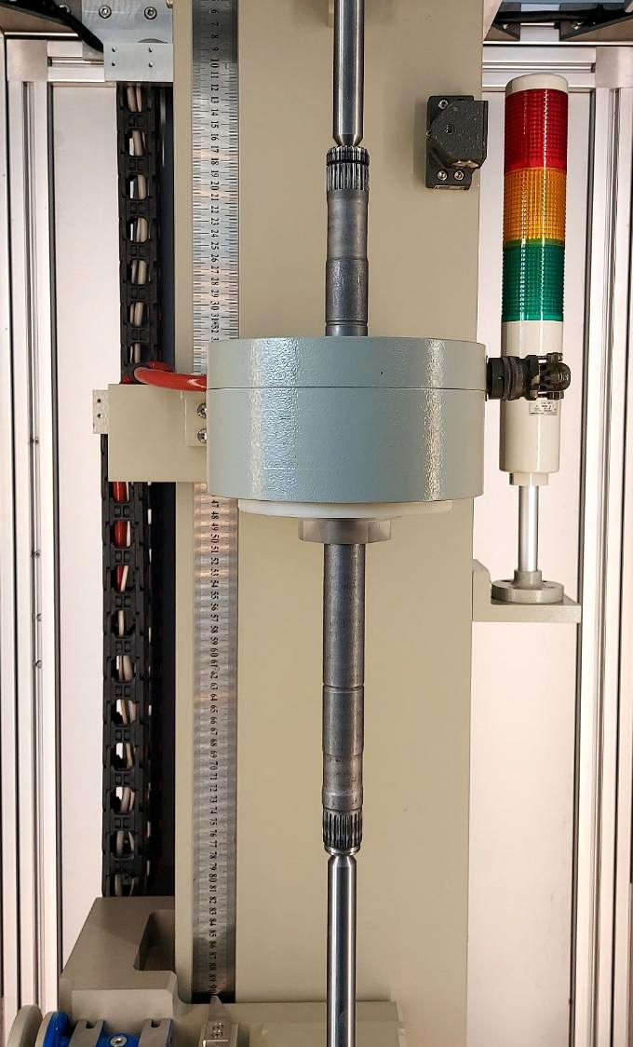

Moving Coil Scanning: Redefining Precision
Full-Length Precision:
  The moving coil scans along the entire axle bar, capturing high-resolution data at every point.
Adaptive to Complex Geometries:
  Adjusts seamlessly to grooves, splines, and transitions, ensuring accuracy even in challenging areas.
Sharper Measurement Focus:
  Advanced algorithms enhance detail, delivering clear and precise case depth profiles.
Superior to Fixed-Coil Systems:
  Eliminates the blurring and inaccuracies typical of static coils, maintaining consistent precision.
Notes:
Now, let’s look at how the EddySonix ECS achieves precision through its Moving Coil Scanning technology.
Unlike static systems, the ECS uses a moving coil that scans along the entire axle bar. This dynamic motion ensures high-resolution measurements at every point, delivering consistent accuracy across the length of the bar.
To handle complex geometries like splines and grooves, the ECS employs adaptive algorithms. These algorithms focus on critical areas, ensuring precise measurements where traditional systems might fail.
In the visual, the green arrow represents the scanning direction. As the coil moves, it maintains sharp focus, creating highly detailed case depth profiles while avoiding the inaccuracies of fixed-coil systems.
This combination of motion and advanced focus sets a new standard in non-destructive testing, delivering precision and reliability for a variety of axle bar designs.

Slide 6
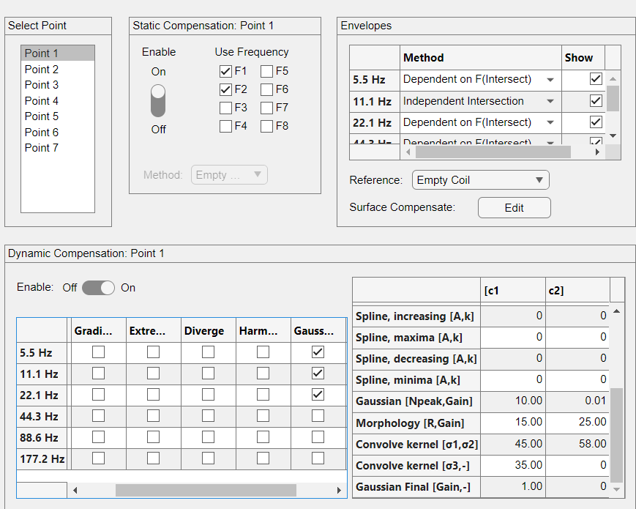
Advanced Compensation: Accuracy Without Limits
Static Compensation:
  Adapts to changes in temperature and material properties during testing.
Surface Compensation:
  Ensures consistent accuracy across varying surface hardness levels.
Dynamic Compensation:
  Handles complex geometries like splines, grooves, and transitions with precision.
Calibration-Free Performance:
  Achieves lifetime accuracy without requiring periodic recalibration.
Notes:
Let’s now look at how the EddySonix ECS achieves consistent accuracy across varying conditions through its Advanced Compensation Mechanisms.
The system employs a three-tier compensation approach, allowing it to adapt seamlessly to different challenges:
Static Compensation adjusts for external factors like temperature changes and material variations. This ensures the ECS delivers reliable measurements, even in fluctuating environments.
Surface Compensation comes into play when dealing with different surface hardness levels. It ensures that the test results remain consistent, regardless of the variations in surface conditions.
Finally, Dynamic Compensation enables the ECS to handle complex geometries, such as splines, grooves, and transitions. This is critical for axle bars with intricate designs, where traditional systems often fail to maintain precision.
What’s even more remarkable is that the ECS achieves this level of accuracy without requiring periodic recalibration. Once calibrated, it maintains lifetime accuracy, saving both time and operational costs.
By integrating these advanced compensation mechanisms, the EddySonix ECS guarantees precise, reliable results, regardless of material, geometry, or environmental conditions.

Slide 7
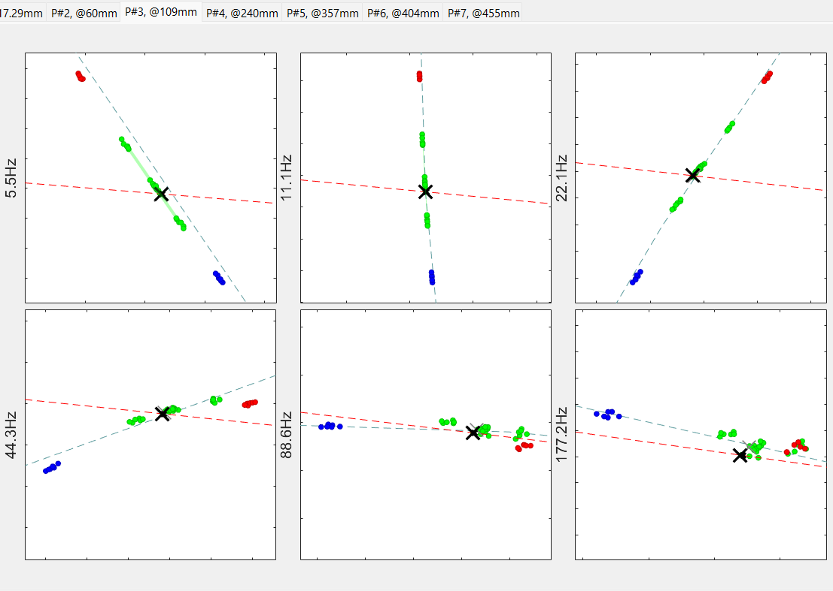
Multi-Frequency Processing: Enhanced Accuracy
Low Frequency:
  Penetrates deeper into the material, ensuring accurate case depth measurements.
Medium Frequency:
  Balances penetration depth and surface resolution for optimal accuracy.
High Frequency:
  Captures fine surface details, critical for complex geometries.
Integrated Processing:
  Combines all frequency bands to deliver a detailed and reliable profile.
Notes:
One of the key innovations of the EddySonix ECS is its ability to utilize Multi-Frequency Processing, which enhances both the depth and precision of case depth measurements.
Low Frequencies are used to penetrate deeper into the material, providing accurate measurements for the overall case depth. This ensures we capture the full depth profile reliably.
Medium Frequencies strike a balance between penetration depth and surface resolution, delivering optimal accuracy for a wide range of material geometries and conditions.
High Frequencies focus on capturing fine surface details. This is especially critical for parts with complex geometries or surface-level characteristics that need detailed analysis.
Finally, the system’s Integrated Processing combines all these frequency bands to create a comprehensive and reliable profile, tailored specifically to the material being tested. This multi-layered approach ensures no details are missed, whether at the surface or deeper within the part.
The scatter plots here illustrate how the system evaluates the material’s characteristics across different frequency ranges, ensuring accuracy and consistency.

Slide 8
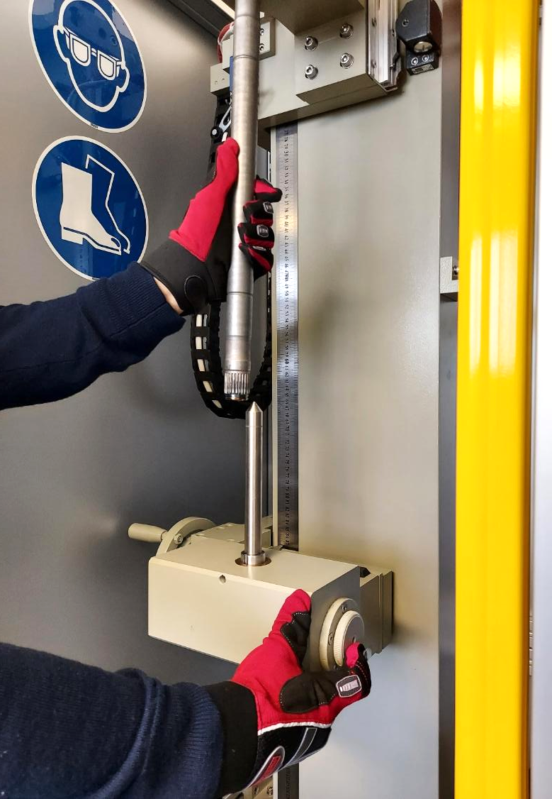
Scalable Design for All Axle Bar Sizes
Adjustable Tailstock:
  Quickly adapts to different axle bar lengths and diameters for seamless operation.
Wide Range Support:
  Lengths: Supports axle bars up to 1000mm.
  Diameters: Handles bars up to 40mm in diameter.
Scalable System:
  Built to accommodate any axle bar size or type with minimal setup adjustments.
High Efficiency:
  Simplified adjustments reduce downtime when switching between different bar specifications.
Notes:
The EddySonix ECS is designed with scalability in mind, making it adaptable to axle bars of all sizes. The system features an adjustable tailstock that can be reconfigured quickly and easily for new bar types.
It supports axle bars of up to 1000mm in length and 40mm in diameter, providing unmatched versatility in its class. Whether you’re testing small or large parts, the ECS ensures precision without additional complexity.
The system’s scalability means that manufacturers can integrate it into various production lines without hassle, accommodating diverse axle bar types with minimal setup adjustments. This flexibility saves valuable time and maximizes efficiency during operations.

Slide 9
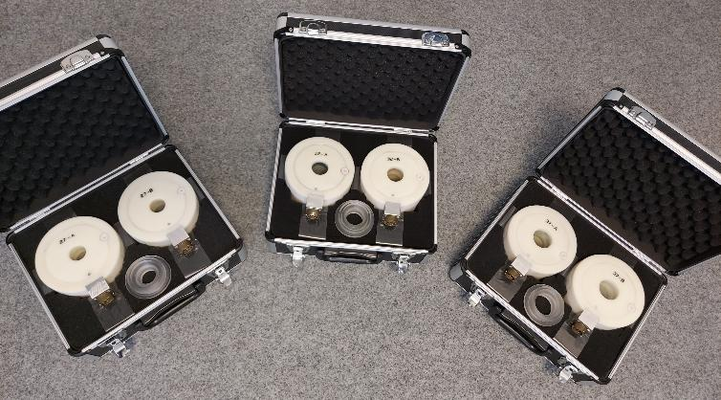
Innovative Coil Design: Tailored for Precision and Efficiency
Intelligent Compatibility
  Unique Coil Identification: Each coil is equipped with a unique ID that communicates with the system to ensure it matches the specific axle bar program, preventing errors.
Flexible Size Options
  Standard Sizes: Supports diameters of 27mm, 32mm, and 37mm.
  Custom Coils: Tailored to order, with diameters up to 100mm.
Rapid Replacement
  Quick Change: Coils can be replaced in just 30 seconds, minimizing downtime and improving efficiency.
Enhanced Design
  Ferrite Concentrators: Advanced concentrators embedded in the coil design optimize magnetic focus, enhancing measurement accuracy and precision.
Notes:
Our advanced coil technology is designed to ensure both precision and efficiency during testing.
First, each coil is equipped with a unique ID, which communicates directly with the system to verify compatibility with the selected axle bar program. This eliminates the risk of errors and ensures a seamless workflow.
In terms of sizing, the ECS supports standard coil diameters of 27mm, 32mm, and 37mm, with the flexibility to design custom coils up to 100mm, allowing manufacturers to adapt to a wide range of axle bar specifications.
When it’s time for a replacement, the coils are designed for rapid changeovers—a quick and easy process that takes only 30 seconds, reducing downtime and maintaining high throughput.
Lastly, the coils are built with ferrite concentrators, which enhance magnetic focus for precise and accurate measurements, even in demanding testing environments. This cutting-edge design demonstrates our commitment to quality and innovation in non-destructive testing.

Slide 10
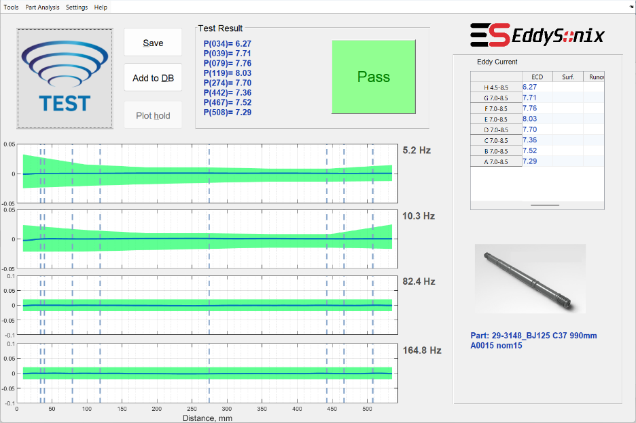
Example: Nominal Part Test Results
Defined Points:
  The Eddy Current Scanner (ECS) measures the Effective Case Depth (ECD) at predefined points along the axle bar.
Accurate Measurements:
  The results are displayed in a table for easy analysis.
High Precision:
  The system delivers exceptional accuracy, with a standard deviation (std) of 0.15mm and a maximum deviation error of 0.3mm when compared to real microhardness tests.
Notes:
In this slide, we see an example of a Nominal Part tested using the EddySonix ECS.
The system measures the Effective Case Depth (ECD) at predefined points along the axle bar, ensuring uniform coverage across its length. These measurements are displayed in the table for easy analysis, providing a clear breakdown of results for each point.
What makes the ECS stand out is its high precision. The accuracy of the system is remarkable, with a maximum deviation error of just 0.15mm when compared to traditional microhardness tests. This ensures that the results you see are highly reliable and consistent.

Slide 11
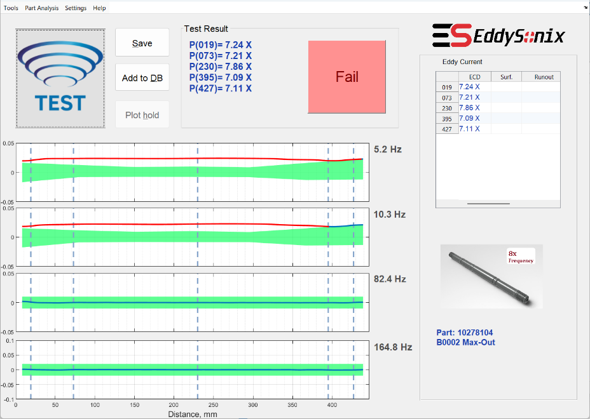
Testing a Max-Out Part: Critical Failure Analysis
Test Results:
  The part fails due to excessive Effective Case Depth (ECD) at all points.
  Failure is marked with a red ‘X’ in the table and visualized in the graphs.
Visual Indicators:
  Envelopes clearly show ECD exceeding limits along the entire part.
  Frequency analysis (5.2Hz & 10.3Hz) confirms out-of-range readings.
Database Validation:
  Max-Out classification helps train the database for future defect detection.
Notes:
This slide demonstrates the testing of a Max-Out part, where the Effective Case Depth (ECD) exceeds acceptable limits.
Test Results: The failure is indicated with red 'X' marks in the table and visualized in the graphs, showing excessive ECD across all points.
Visual Indicators: The envelopes in the graphs clearly display ECD values exceeding limits, with frequency analysis (e.g., 5.2Hz and 10.3Hz) confirming out-of-range readings.
This highlights the system’s precision in detecting critical failures, ensuring robust quality control.

Slide 12
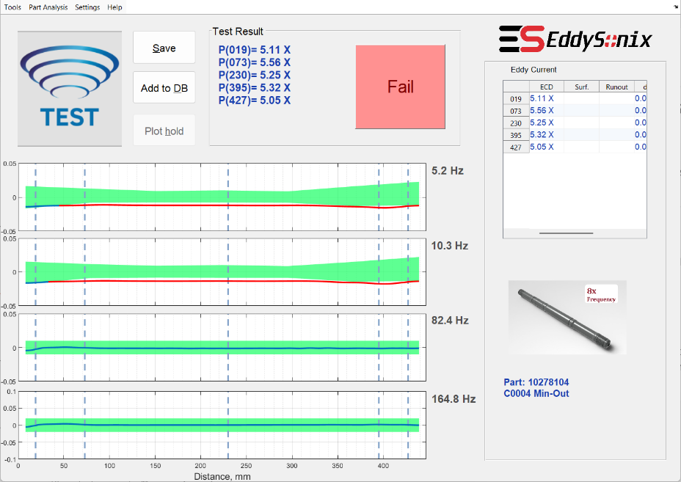
Testing a Min-Out Part: Shallow Case Depth
Test Results:
  The part fails due to shallow Effective Case Depth (ECD) at all points.
  Failure is marked with a red ‘X’ in the table and visualized in the graphs.
Visual Indicators:
  Envelopes display ECD values below the minimum threshold along the part.
  Frequency analysis (5.2Hz & 10.3Hz) confirms below-range readings.
Database Validation:
  Min-Out classification ensures future parts with shallow case depth are reliably detected.
Notes:
This slide demonstrates the testing of a Min-Out part where the Effective Case Depth (ECD) is below the acceptable threshold.
Test Results: Failure is marked with red 'X' in the table and graphs due to shallow ECD.
Visual Indicators: Graph envelopes highlight below-threshold values across all points.
The system ensures precise identification of shallow case depth defects for quality control.

Slide 13
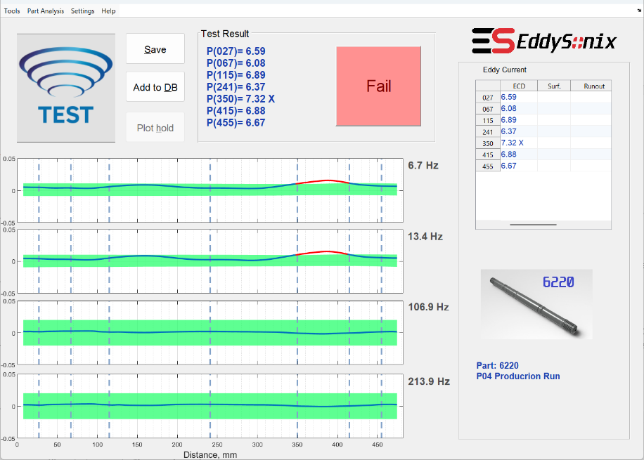
Testing a Local Defect: Pinpoint Accuracy
Localized Failure:
  Point P(350mm) exceeds the acceptable ECD limit (7.32 X), while other points pass within acceptable ranges.
Graphical Analysis:
  Red and lines in the ECD envelopes clearly highlight the defect.
Real-World Application:
  Demonstrates the ECS’s ability to pinpoint discrete defects in production parts, ensuring thorough quality control.
Notes:
This slide showcases the EddySonix ECS’s ability to detect localized defects with pinpoint accuracy.
Localized Failure: The system identifies a defect at Point P(350mm), where the ECD value exceeds the acceptable limit (7.32mm X). All other points pass within the specified range.
Graphical Analysis: Red markers and deviations in the frequency envelopes clearly highlight this localized defect.
This example demonstrates how the system ensures thorough quality control by pinpointing specific defects in production parts.

Slide 14
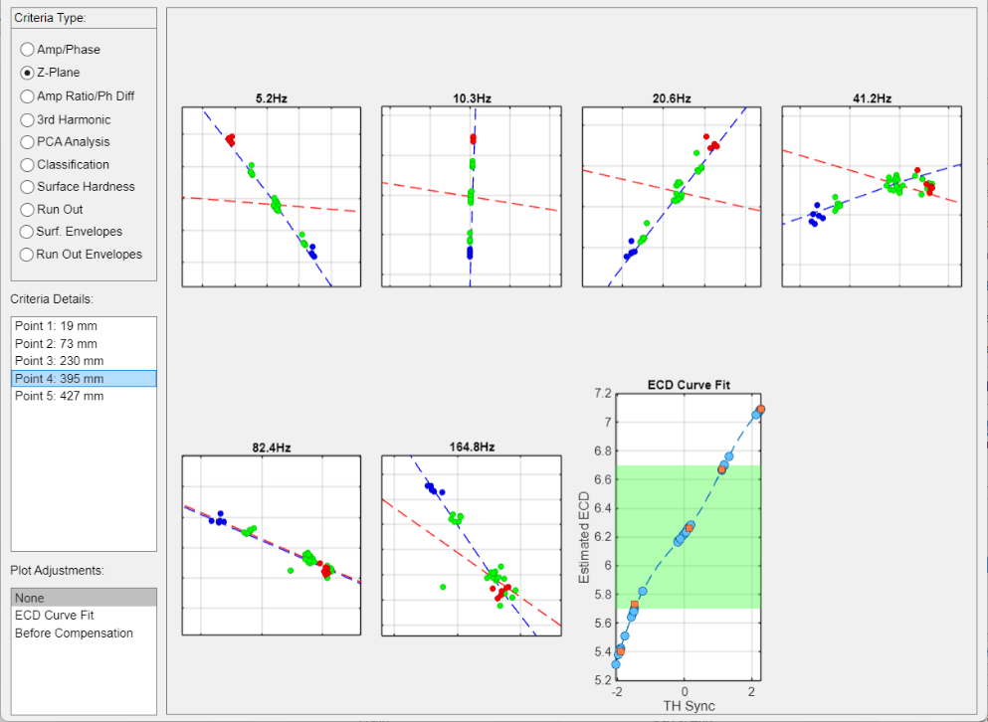
Extensive Tools for Database Training and Analysis
Impedance Planes:
  Displays the response for multiple frequencies (e.g., 5.2Hz to 164.8Hz) for detailed analysis and training validation.
ECD Estimation:
  Provides precise Effective Case Depth (ECD) values at each defined point, visualized with curve fits and validation ranges.
Database Training:
  Offers interactive tools for creating and validating a robust reference database for Nominal, Max, and Min criteria.
Defined Points:
  Results are shown for each predefined point (e.g., 19mm, 73mm, etc.), ensuring accuracy across the entire axle bar.
Notes:
This slide highlights the advanced tools available in the EddySonix ECS for database training and material analysis.
Impedance Planes: These graphs display the response across multiple frequencies, from 5.2Hz to 164.8Hz, providing in-depth material analysis and validation.
ECD Estimation: The system calculates precise Effective Case Depth values at predefined points, visualized with curve fits and validation ranges.
Database Training: Interactive tools enable the creation and validation of a robust reference database for Nominal, Max-Out, and Min-Out criteria.
Defined Points: Results are analyzed at specific points along the axle bar (e.g., 19mm, 73mm, etc.) to ensure accuracy across the entire length.
These features ensure reliable analysis and enhance the system's learning capabilities for ongoing improvement.

Slide 15
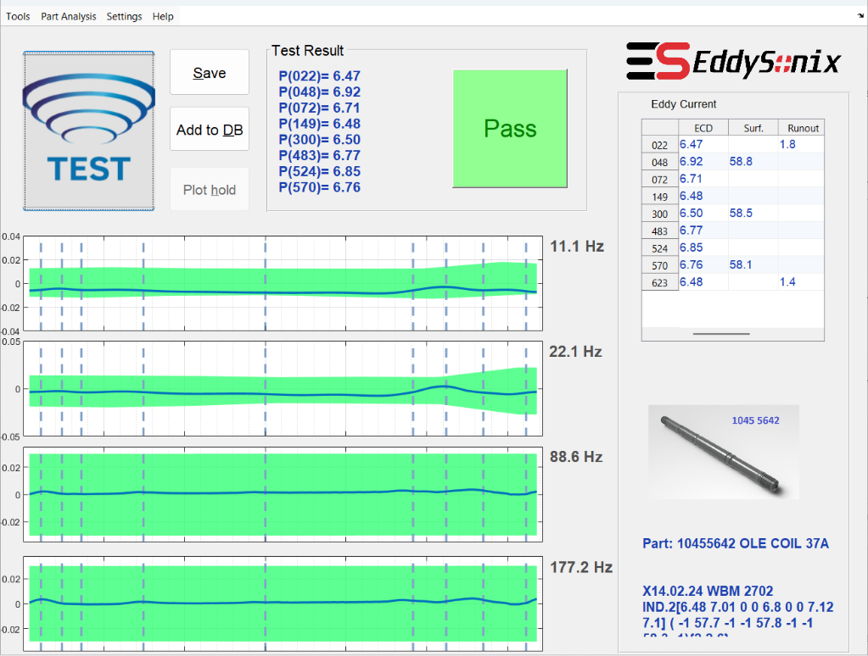
Optional Reports: Surface Hardness and Runout Testing
Surface Hardness Testing:
  Measures surface hardness at specific points with a validated error of ±1.5 HRC.
  Provides detailed scatter plots and profiles for hardness evaluation.
Runout Testing:
  Reports the distance from the part’s end where material remains raw (not hardened).
  Ensures consistent runout with a maximum error of ±1mm.
Additional Insights:
  Fully integrated with Batch Testing for efficient analysis.
  Enhances traceability through detailed statistical and graphical reports.
Comprehensive Reports: ECD, Surface Hardness, and Runout Measurements
Notes:
This slide highlights the optional reporting capabilities of the EddySonix ECS system, focusing on Surface Hardness and Runout Testing.
Surface Hardness Testing:
The system measures surface hardness at specific points with a validated error of ±1.5 HRC. It provides detailed scatter plots and profiles, offering a comprehensive evaluation of the material’s surface hardness.
Runout Testing:
This feature reports the distance from the edge of the part where the material remains raw, ensuring consistent hardening with a maximum error of ±1mm.
Additional Insights:
These reports are fully integrated with Batch Testing for efficient analysis and enhance traceability through detailed statistical and graphical outputs.
Together, these optional tools provide advanced insights, complementing the core ECD measurements and ensuring production quality at every level.

Slide 16
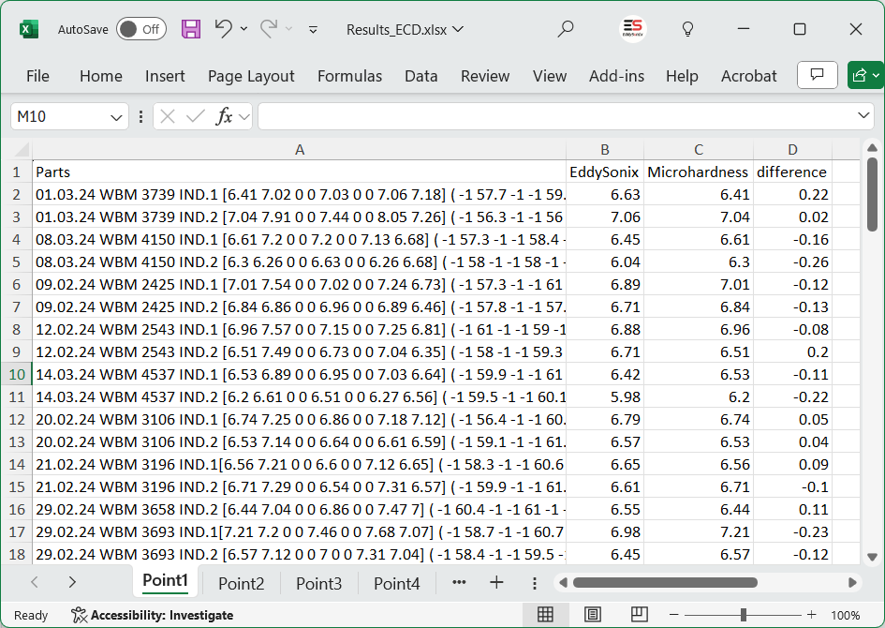
Batch Test: Comprehensive Statistical Analysis
Offline Analysis:
  Process all test files in a folder to generate statistical reports.
Comparison with Microhardness:
  Validate EddySonix ECD results with known cut-check values.
Reports Generated:
  Scatter plots and Bland-Altman analysis.
  Excel sheets with RMSE, correlation, and error metrics.
Data Requirements:
  At least 30 samples with a mix of nominal and defective parts.
Notes:
This slide highlights the Batch Test feature of EddySonix ECS, enabling detailed statistical analysis for quality assurance.
Offline Analysis: Batch Test processes all test files in a folder, generating comprehensive statistical reports for in-depth insights.
Comparison with Microhardness: The system validates EddySonix ECD results against known cut-check values, ensuring reliability and precision.
Reports Generated: Outputs include scatter plots, Bland-Altman analysis, and Excel sheets with key metrics like RMSE, correlation coefficients, and error values.
Data Requirements: To obtain meaningful results, at least 30 samples with a mix of nominal and defective parts are recommended.
This feature is a powerful tool for validating production quality and improving database accuracy through robust statistical evaluations.

Slide 17
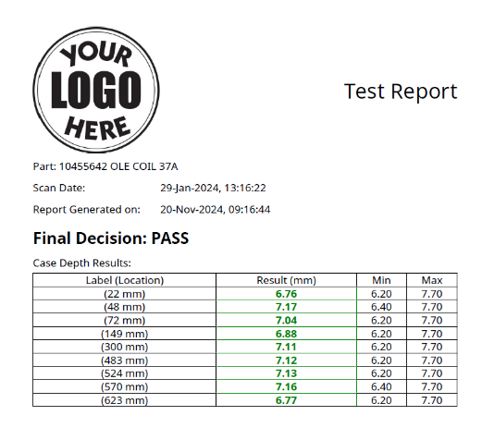
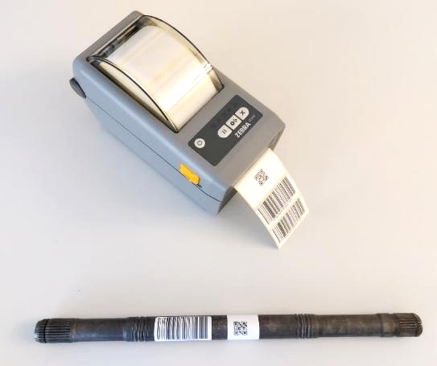
Report Generation and Barcode Printing for Traceability
Generate Reports:
  Detailed test reports, including case depth results and pass/fail decisions, are automatically created after each test.
  Reports can be transferred to a network path for easy traceability.
Barcode Printing:
  Generate a barcode with a unique serial number for the tested part.
  Attach the barcode to the part for future reference and tracking.
Seamless Integration:
  Zebra ZD410 barcode printer support for 1D or 2D (QR-code) labels.
  Define network paths and barcode settings via the Settings menu.
Notes:
The EddySonix ECS includes a robust traceability system to ensure every test is documented and accessible.
After each test, a detailed test report is generated, showing critical data such as case depth measurements, pass/fail decisions, and part-specific details. Pressing the ‘Q’ key allows users to transfer this report to a predefined network path and generate a barcode for the part.
The system supports Zebra ZD410 barcode printers, capable of printing 1D or 2D QR-code labels. These labels can be attached to the tested part for easy tracking and future reference.
Settings for network paths and barcode configuration are fully customizable via the Settings menu, ensuring seamless integration with traceability programs.

Slide 18
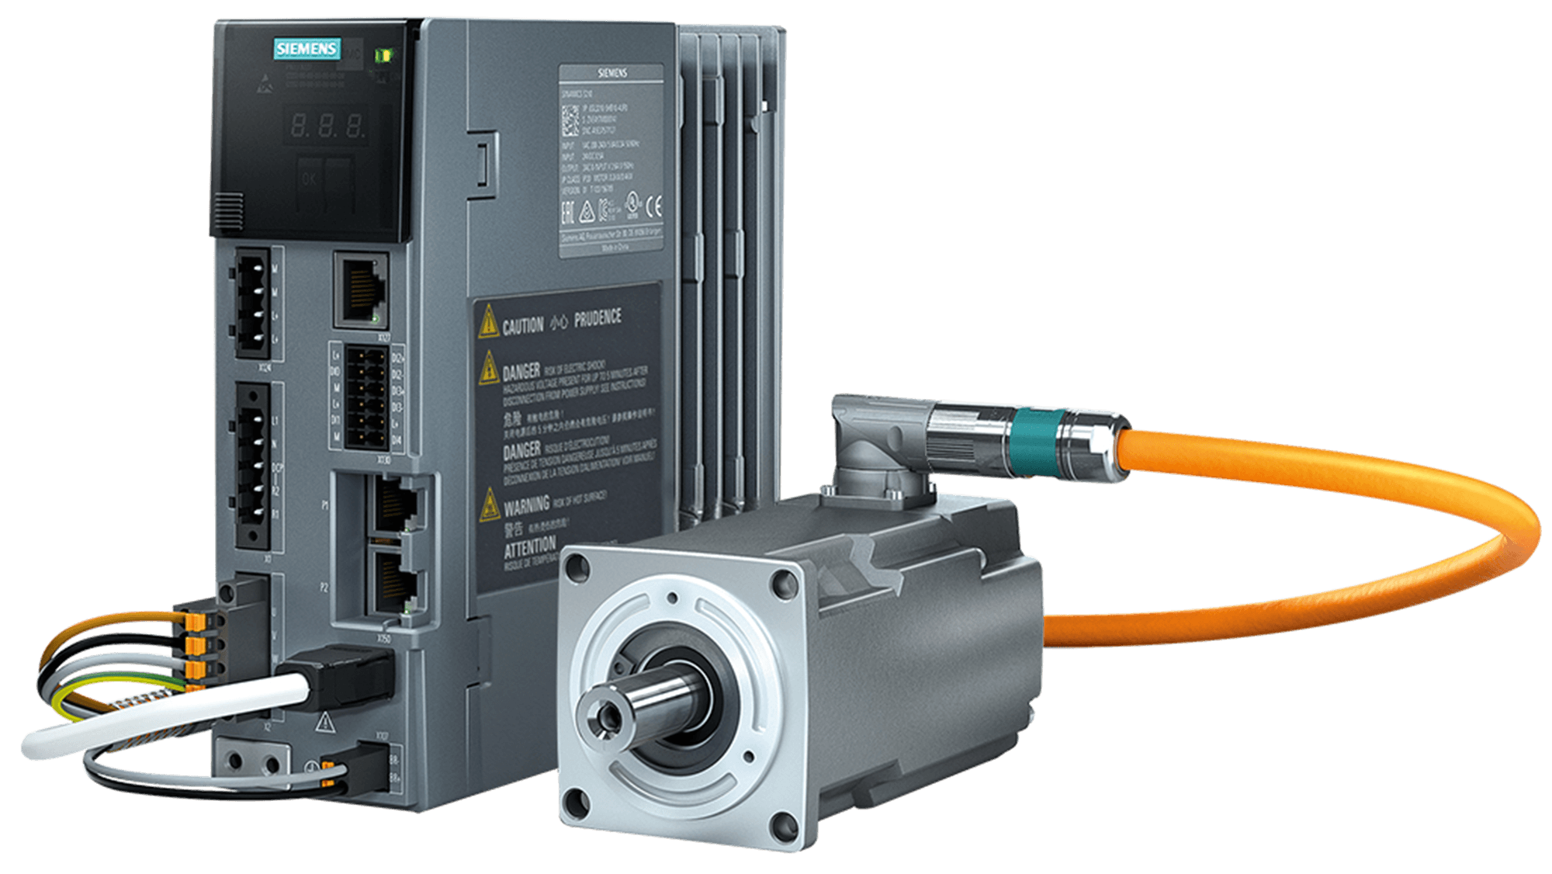

Siemens Components: Trusted Quality for Reliable Performance
Premium Design:
  Electrical panel, servo motor, servo drive, and PLC—all Siemens.
Service-Friendly:
  Siemens software simplifies troubleshooting, minimizing downtime.
Proven Durability:
  Ensures high reliability and top-tier performance across all operations.
Notes:
This slide highlights the premium quality and proven reliability of the Siemens components integrated into the EddySonix ECS system.
First, the system is built with a premium design, using Siemens components across critical areas like the electrical panel, servo motor, servo drive, and PLC. These components form the backbone of the system, ensuring precise and dependable operations.
Next, the system is incredibly service-friendly. Siemens software simplifies troubleshooting and maintenance, helping operators resolve issues quickly and minimizing downtime. This contributes directly to smoother and more efficient production processes.
Finally, the Siemens components offer proven durability. With a track record of high reliability and top-tier performance, they ensure the ECS operates consistently, even in demanding industrial environments.
This combination of high-quality design, service-friendly features, and durability makes Siemens components a key factor in the ECS's outstanding performance and reliability.

Slide 19
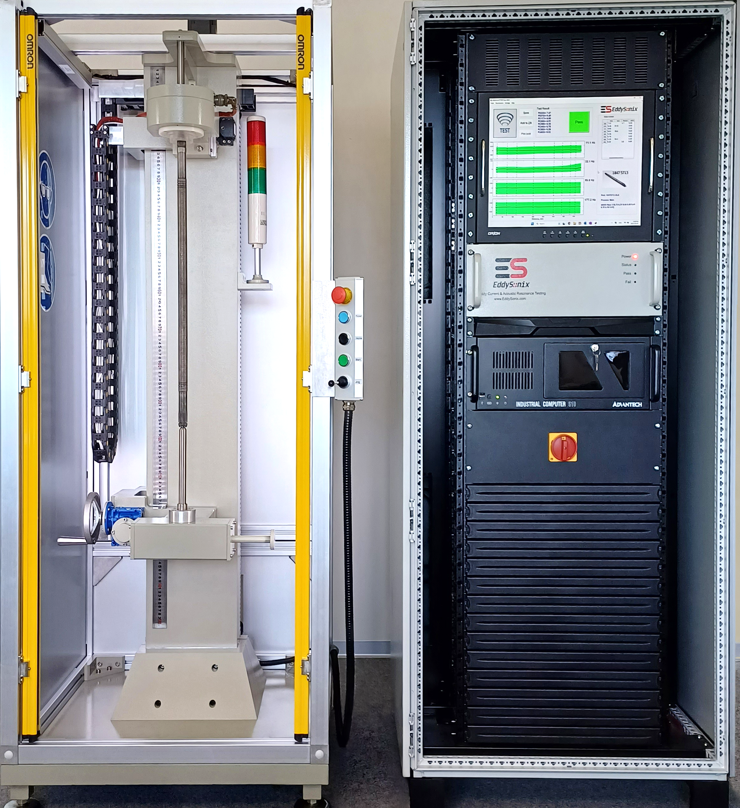

Over-Designed for Maximum Reliability
High-Performance Components:
  Siemens servo motors, PLCs, and industrial-grade parts ensure zero failures since 2017.
Certified Safety:
  CE-approved for compliance with global safety standards, ensuring operator protection.
  Rack Unit IP65-Certified: Protects electrical components against dust and water.
  Features advanced safety systems like Omron light curtains with a 14mm finger resolution for enhanced operator safety.
Heavy-Duty Build:
  Robust mechanics designed for continuous use in high-production environments without downtime.
Notes:
This slide highlights the robustness and reliability of the EddySonix ECS, which has been over-designed to ensure maximum performance in even the most demanding industrial environments.
First, the system is equipped with high-performance components. Siemens servo motors, PLCs, and other industrial-grade parts have delivered zero operational failures since 2017, demonstrating unmatched reliability and longevity.
Safety is a core priority. The ECS is CE-approved, meeting global safety standards to protect operators and ensure compliant operations. Additionally, the rack unit is IP65-certified, safeguarding critical electrical components against dust and water. This ensures the system's durability and protection in challenging environments.
To further enhance safety, the system features Omron light curtains, which provide advanced operator protection by preventing accidental exposure during operation.
Finally, the ECS boasts a heavy-duty build, designed for continuous use in high-production environments. Its robust mechanics ensure uninterrupted operation, making it an ideal choice for industries that demand precision and reliability at scale.
Together, these features make the EddySonix ECS a benchmark in reliability and performance.

Slide 20
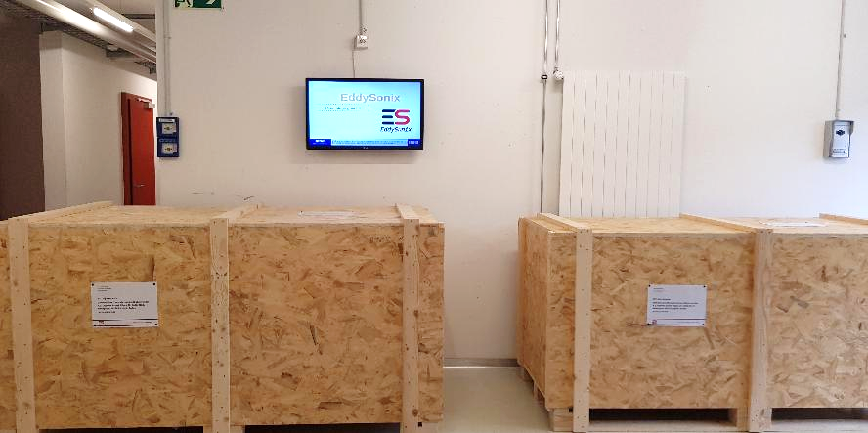
Packaging, Delivery, and On-Site Support
Packaging Standards:
  Crates meet ISPM15 standards for international shipping, ensuring compliance with global regulations.
Delivery Timeline:
  Products delivered within 4 weeks after order confirmation.
On-Site Services:
  Includes installation, setup, and training at the plant, scheduled for 5 days, available worldwide.
Warranty and Support:
  Backed by a 24-month warranty starting from the date of delivery.
  Includes 2 years of comprehensive support to ensure smooth operations.
Specifications:
  Palette 1 (Hardware Rack): 2100x1080x1100mm, 400kg gross, 290kg net.
  Palette 2 (Mechanical Unit): 2100x1080x1100mm, 500kg gross, 400kg net
Notes:
Our packaging, delivery, and support processes ensure a seamless experience for our customers.
The EddySonix ECS system is delivered in secure crates that meet ISPM15 international shipping standards, safeguarding the equipment during transit. Delivery is guaranteed within 4 weeks of order confirmation.
Upon arrival, our team provides on-site installation, setup, and training, conducted over 5 days to ensure the system is fully operational. The product also includes a 24-month warranty and 2 years of comprehensive support, ensuring reliable performance and assistance when needed.
The shipment is organized into two palettes:
Palette 1 houses the Hardware Rack, measuring 2100x1080x1100mm, with a gross weight of 400kg.
Palette 2 contains the Mechanical Unit, with the same dimensions and a gross weight of 500kg.

Slide 21

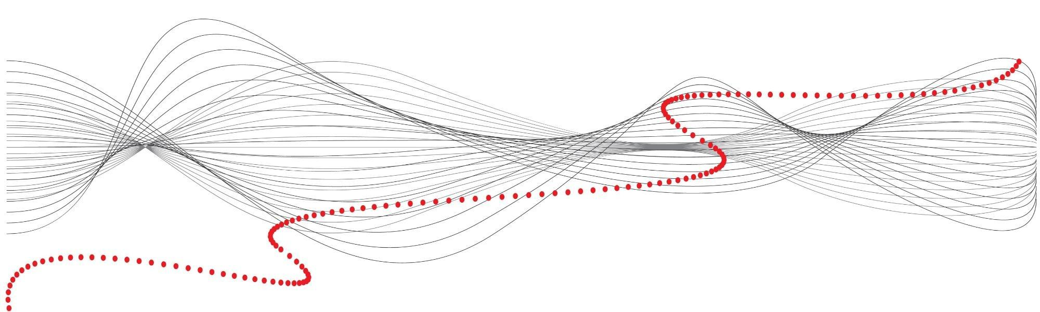
We appreciate your time and interest in EddySonix’s innovative solutions for precision defect detection.
Notes:
Thank you for your time and attention. At EddySonix, we’re dedicated to advancing non-destructive testing technology to meet the highest standards in precision and reliability. If you have any questions or would like to learn more about how ECS technology can support your specific needs, please don’t hesitate to reach out.

